Slide 1


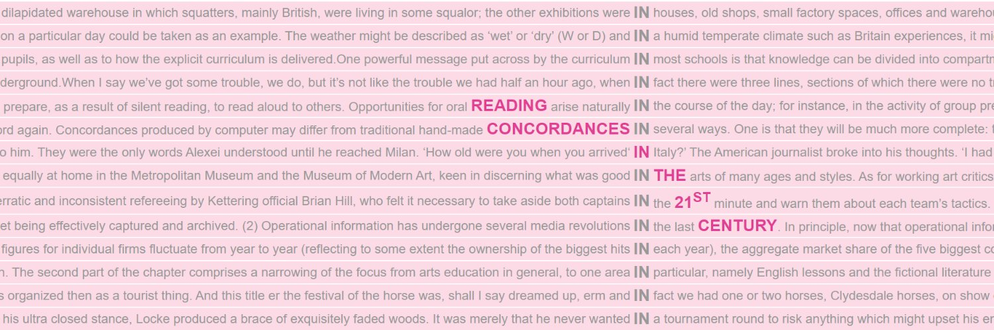



1
Reading concordances with algorithms
Konvens 2025 Tutorial | 9 Sep 2025
Reading Concordances in the 21st Century (RC21) project team
Nathan Dykes • Stephanie Evert • Michaela Mahlberg • Alexander Piperski

Slide 2
Overview of the tutorial
Part I
Concordance reading
Strategies for organising concordances
Reading concordances with algorithms
A mathematical framework
Part II
Hands-on: FlexiConc in Jupyter
Implementation details
Loading your own data

Slide 3
Orientation
What we're going to look at now …
What is a concordance?
When do you use them?
How can we make sense of concordances?

Slide 4
A concordance …
Collects all the occurrences of a search term (the node) in a corpus (or a lexico-grammatical pattern matching a corpus query)
Usually displayed in a compact tabular format suitable for “vertical reading”: kwic = keyword in context (Luhn 1960)
Well-suited for identifying recurrent patterns, often by rearranging lines with the help of concordancer software
Link between “distant reading” and “close reading” in DH

Slide 5
A concordance …
s flagship Odeon cinema said: `I am afraid Ally's been subbed." <p> Rangers
notions in ten years. I'm afraid I have to tell you that I believ
company operations you own; I'm afraid I've got to get some detail." <
ou know me?" he said grumpily. `I'm afraid I don't know you. I've shaved
of that band of loonies? I'm afraid it's just no contest at all. <h
hellip; we cocoon because we are afraid of saying the wrong thing or not
a Pullman, and partly because he was afraid of being seen there by some
attacks. They think she is afraid of upsetting the politicians lin
Into the lens, but equally do not be afraid of photographing against the lig
because health professionals were afraid to cross lines marking religious
willowy decadence, blase, stupid, afraid to be seen sober or with a book,
t say yea <p> or nay, and he was afraid to ask. <p> When the new field l
with their eyes what they were afraid to put into words. Is it possib
Monica) Lewinsky report, you are afraid to put a cigar in your mouth. Th
Notes:
Lexicography – and marking up on paper

Slide 6
A concordance illustrates patterns of a word
s flagship Odeon cinema said: `I am afraid Ally's been subbed." <p> Rangers
notions in ten years. I'm afraid I have to tell you that I believ
company operations you own; I'm afraid I've got to get some detail." <
ou know me?" he said grumpily. `I'm afraid I don't know you. I've shaved
of that band of loonies? I'm afraid it's just no contest at all. <h
hellip; we cocoon because we are afraid of saying the wrong thing or not
a Pullman, and partly because he was afraid of being seen there by some
attacks. They think she is afraid of upsetting the politicians lin
Into the lens, but equally do not be afraid of photographing against the lig
because health professionals were afraid to cross lines marking religious
willowy decadence, blase, stupid, afraid to be seen sober or with a book,
t say yea <p> or nay, and he was afraid to ask. <p> When the new field l
with their eyes what they were afraid to put into words. Is it possib
Monica) Lewinsky report, you are afraid to put a cigar in your mouth. Th
Notes:
Lexicography – and marking up on paper

Slide 7
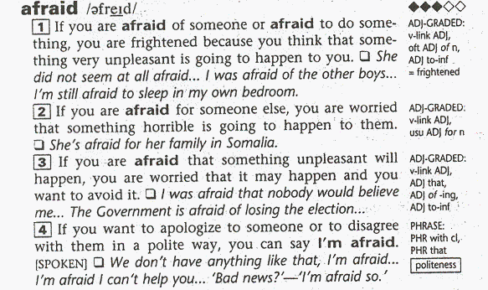
Sinclair, J. McH. (ed.) (1987). Collins Cobuild English Language Dictionary: Helping Learners with Real English. Collins ELT.

Slide 8
Theoretical background
v-link ADJ of
I was afraid of the other boys.
v-link ADJ to-inf
I'm still afraid to sleep in my own bedroom.
Pattern Grammar
“a pattern is a phraseology frequently associated with (a sense of) a word, particularly in terms of the prepositions, groups, and clauses that follow the word.”
(Hunston & Francis 2000)

Slide 9
Controversy patterns in text-initial sent's of news reports (Mahlberg & O'Donnell 2008)
Ken Livingstone has provoked a fresh row with the motoring lobby …
The RUC was plunged into fresh controversy last night when …
Reform of the Lords will erupt into fresh controversy today when a minority …
THE BBC was facing fresh embarrassment last night when one of its most senior news presenters attacked managers for undermining television news coverage.
FACE/SPARK | fresh | NOUN | ABOUT | TIME | AFTER
be embroiled in | fresh | controversy | over | yesterday | when
be at the centre of |  | row | about | last night | as
be dealt |  | embarassment | to | today
ignite |  | blow
heap on
erupt

Slide 10
Lexical item (e.g. Sinclair 1988)
Core
Collocation
Colligation
Semantic preference
Semantic prosody
Famous examples: naked eye, true feelings, budge

Slide 11
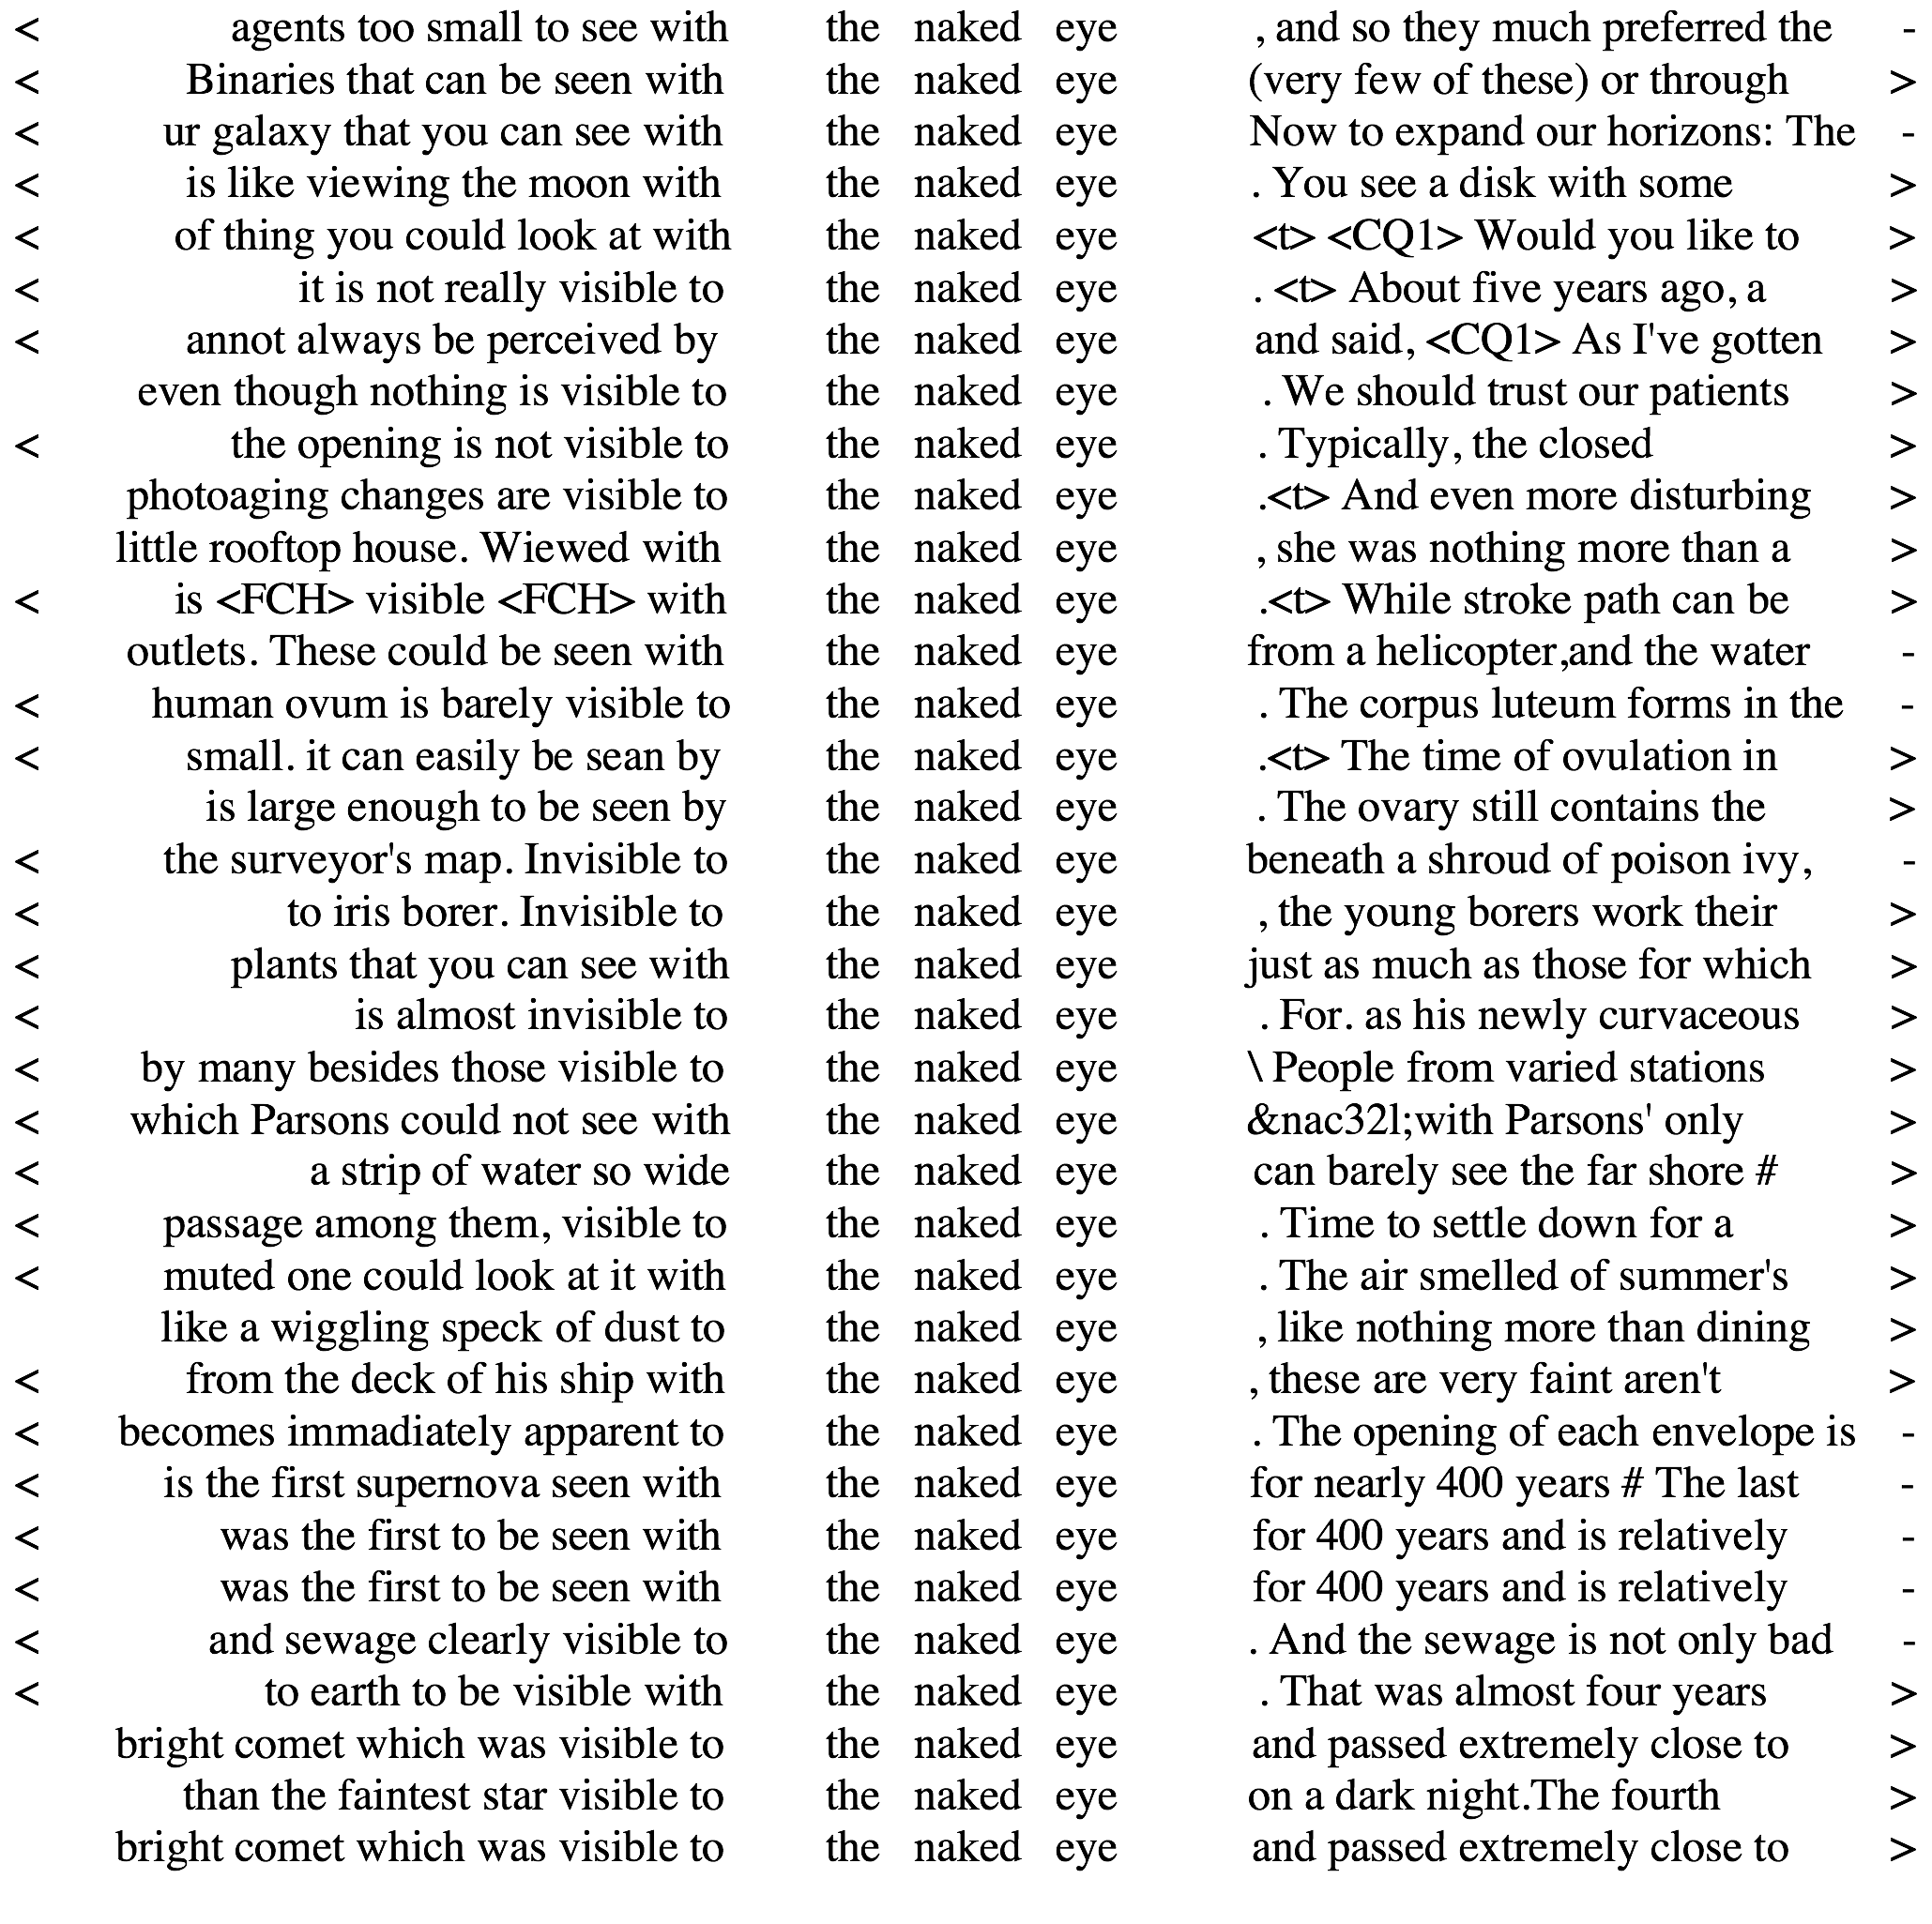

Slide 12
Hands-on: manual concordance reading
Activity
What patterns can you detect in the following two concordances?
You might want to think in terms of collocations, colligation, semantic preference, and semantic prosody

Slide 13
to really let rip with their true feelings, only time will tel
of being able to hide her true feelings. In public life th
are goin through and their true feelings. And anyway Don, y
of our inability to mask our true feelings was unearthed by J
leaves little doubt as to his true feelings. And as for Li X
calm and composed, masking her true feelings. So her demeanour w
accounts, has now conveyed his true feelings. We await the out
as a cloak to disguise their true feelings. Deborah Bruce's p
ve watched her. No doubt her true feelings were emerging from
he may prefer to let his true feelings out in print. Today
that - even if those were his true feelings. Instead he did s
moist-eyed, and makes known her true feelings, what does Parker d
get a hint of Do Thi's true feelings but Caine and Fra
of being able to hide her true feelings. In public life th
to invade Iraq. Whatever his true feelings about the war, the
perhaps an indicator of his true feelings. FROM REED ORGAN TO
Chapman's words revealed his true feelings towards his child's
is meaningless.' Whatever his true feelings on the high- vers
Kent last week let slip her true feelings about royal li
tune she marries him, but her true feelings are even displayed
evidence of “Old Europe’s” true feelings towards Britain when
speak the truth or reveal your true feelings because that's NOT
run. If he was disguising his true feelings he did it masterfully
ple being able to express their true feelings of rawness and to p
Chilean cities to express their true feelings about this fateful

Slide 14
to really let rip with their true feelings, only time will tel
of being able to hide her true feelings. In public life th
are goin through and their true feelings. And anyway Don, y
of our inability to mask our true feelings was unearthed by J
leaves little doubt as to his true feelings. And as for Li X
calm and composed, masking her true feelings. So her demeanour w
accounts, has now conveyed his true feelings. We await the out
as a cloak to disguise their true feelings. Deborah Bruce's p
ve watched her. No doubt her true feelings were emerging from
he may prefer to let his true feelings out in print. Toda
that - even if those were his true feelings. Instead he did s
moist-eyed, and makes known her true feelings, what does Parker d
get a hint of Do Thi's true feelings but Caine and Fra
of being able to hide her true feelings. In public life th
to invade Iraq. Whatever his true feelings about the war, the
perhaps an indicator of his true feelings. FROM REED ORGAN TO
Chapman's words revealed his true feelings towards his child's
is meaningless.' Whatever his true feelings on the high- vers
Kent last week let slip her true feelings about royal li
tune she marries him, but her true feelings are even displayed
evidence of “Old Europe’s” true feelings towards Britain when
speak the truth or reveal your true feelings because that's NOT
run. If he was disguising his true feelings he did it masterfully
ple being able to express their true feelings of rawness and to p
Chilean cities to express their true feelings about this fateful
colligation

Slide 15
to really let rip with their true feelings, only time will tel
of being able to hide her true feelings. In public life th
are goin through and their true feelings. And anyway Don, y
of our inability to mask our true feelings was unearthed by J
leaves little doubt as to his true feelings. And as for Li X
calm and composed, masking her true feelings. So her demeanour w
accounts, has now conveyed his true feelings. We await the out
as a cloak to disguise their true feelings. Deborah Bruce's p
ve watched her. No doubt her true feelings were emerging from
he may prefer to let his true feelings out in print. Today
that - even if those were his true feelings. Instead he did s
moist-eyed, and makes known her true feelings, what does Parker d
get a hint of Do Thi's true feelings but Caine and Fra
of being able to hide her true feelings. In public life th
to invade Iraq. Whatever his true feelings about the war, the
perhaps an indicator of his true feelings. FROM REED ORGAN TO
Chapman's words revealed his true feelings towards his child's
is meaningless.' Whatever his true feelings on the high- vers
Kent last week let slip her true feelings about royal li
tune she marries him, but her true feelings are even displayed
evidence of “Old Europe’s” true feelings towards Britain when
speak the truth or reveal your true feelings because that's NOT
run. If he was disguising his true feelings he did it masterfully
ple being able to express their true feelings of rawness and to p
Chilean cities to express their true feelings about this fateful
colligation
semantic preference

Slide 16
to really let rip with their true feelings, only time will tel
of being able to hide her true feelings. In public life th
are goin through and their true feelings. And anyway Don, y
of our inability to mask our true feelings was unearthed by J
leaves little doubt as to his true feelings. And as for Li X
calm and composed, masking her true feelings. So her demeanour w
accounts, has now conveyed his true feelings. We await the out
as a cloak to disguise their true feelings. Deborah Bruce's p
ve watched her. No doubt her true feelings were emerging from
he may prefer to let his true feelings out in print. Today
that - even if those were his true feelings. Instead he did s
moist-eyed, and makes known her true feelings, what does Parker d
get a hint of Do Thi's true feelings but Caine and Fra
of being able to hide her true feelings. In public life th
to invade Iraq. Whatever his true feelings about the war, the
perhaps an indicator of his true feelings. FROM REED ORGAN TO
Chapman's words revealed his true feelings towards his child's
is meaningless.' Whatever his true feelings on the high- vers
Kent last week let slip her true feelings about royal li
tune she marries him, but her true feelings are even displayed
evidence of “Old Europe’s” true feelings towards Britain when
speak the truth or reveal your true feelings because that's NOT
run. If he was disguising his true feelings he did it masterfully
ple being able to express their true feelings of rawness and to p
Chilean cities to express their true feelings about this fateful
colligation
semantic preference
semantic prosody

Slide 17

Will it always work?
Let's look at a concordance for one of my favourite words: coffee
Which patterns can you spot?
Are they harder to find than for true feelings?

Slide 18
1 ada McDonald’s customer ‘finds dead mouse in coffee’ A McDonald’s customer was not 'loving '
2 alth & Families > Health News International Coffee Day: The health benefits of drinking
3 TV Video Dating Offers Jobs Life & style Coffee Heavy coffee consumption increases death
4 Here are the professions that drink the most coffee Journalists and police officers like to
5 d Drink Video How to make the perfect cup of coffee 'Master of Coffee' at Costa Coffee,
6 d Drink News Is this really the world's best coffee? Taylors have launched what it claims is
7 chael Gove News > Science Can't live without coffee? Your genes are to blame - new study
8 tality Home» Health» Health News Two cups of coffee a day can harm fertility A study has
9 Company Vitality Home» Health Five cups of coffee a day protect against tinnitus, study
10 ve Bulletproof diet: protect your body with coffee and fats Lucy Fry tries out a new high
12 sers rejoice: a French ruling means cheaper coffee capsules will soon be on the shelves.
13 News Starbucks Chestnut Praline Latte: Coffee chain launches first new holiday drink
14 lf Home» Men» Active» Men's Health Too much coffee damages fertility for men A chocolate
15 travel all sections close Drugs Drinking coffee doesn't make you more alert,
16 network Previous | Next | Index Zimbabwe's coffee farmers struggle amid global boom and
17 ner zone What could help make the future of coffee farmers more sustainable? Fairtrade
18 change adaptation takes root in Peruvian coffee farms With the support of Lidl and
19 t of nerve Should you swap the milk in your coffee for a knob of butter? The 'fat white' is
20 ink» Food and Drink Advice Five of the best coffee gadgets If you've taken the bold leap to
21 e» News» Science» Space 'ISSpresso' space coffee machine to be delivered to International
22 IndyBest > House & Garden 11 best capsule coffee machines Become a connoisseur with our
23 hael Gove IndyBest > House & Garden 10 best coffee machines From velvety lattes to espresso
24 D Offers Jobs Comment is free Why drinking coffee makes women full of beans Women who
25 News NHS staff banned from drinking tea or coffee on the job because it looks like they're

Slide 19
1 ada McDonald’s customer ‘finds dead mouse in coffee’ A McDonald’s customer was not 'loving '
2 alth & Families > Health News International Coffee Day: The health benefits of drinking
3 TV Video Dating Offers Jobs Life & style Coffee Heavy coffee consumption increases death
4 Here are the professions that drink the most coffee Journalists and police officers like to
5 d Drink Video How to make the perfect cup of coffee 'Master of Coffee' at Costa Coffee,
6 d Drink News Is this really the world's best coffee? Taylors have launched what it claims is
7 chael Gove News > Science Can't live without coffee? Your genes are to blame - new study
8 tality Home» Health» Health News Two cups of coffee a day can harm fertility A study has
9 Company Vitality Home» Health Five cups of coffee a day protect against tinnitus, study
10 ve Bulletproof diet: protect your body with coffee and fats Lucy Fry tries out a new high
12 sers rejoice: a French ruling means cheaper coffee capsules will soon be on the shelves.
13 News Starbucks Chestnut Praline Latte: Coffee chain launches first new holiday drink
14 lf Home» Men» Active» Men's Health Too much coffee damages fertility for men A chocolate
15 travel all sections close Drugs Drinking coffee doesn't make you more alert,
16 network Previous | Next | Index Zimbabwe's coffee farmers struggle amid global boom and
17 ner zone What could help make the future of coffee farmers more sustainable? Fairtrade
18 change adaptation takes root in Peruvian coffee farms With the support of Lidl and
19 t of nerve Should you swap the milk in your coffee for a knob of butter? The 'fat white' is
20 ink» Food and Drink Advice Five of the best coffee gadgets If you've taken the bold leap to
21 e» News» Science» Space 'ISSpresso' space coffee machine to be delivered to International
22 IndyBest > House & Garden 11 best capsule coffee machines Become a connoisseur with our
23 hael Gove IndyBest > House & Garden 10 best coffee machines From velvety lattes to espresso
24 D Offers Jobs Comment is free Why drinking coffee makes women full of beans Women who
25 News NHS staff banned from drinking tea or coffee on the job because it looks like they're

Slide 20
1 ada McDonald’s customer ‘finds dead mouse in coffee’ A McDonald’s customer was not 'loving '
2 alth & Families > Health News International Coffee Day: The health benefits of drinking
3 TV Video Dating Offers Jobs Life & style Coffee Heavy coffee consumption increases death
4 Here are the professions that drink the most coffee Journalists and police officers like to
5 d Drink Video How to make the perfect cup of coffee 'Master of Coffee' at Costa Coffee,
6 d Drink News Is this really the world's best coffee? Taylors have launched what it claims is
7 chael Gove News > Science Can't live without coffee? Your genes are to blame - new study
8 tality Home» Health» Health News Two cups of coffee a day can harm fertility A study has
9 Company Vitality Home» Health Five cups of coffee a day protect against tinnitus, study
10 ve Bulletproof diet: protect your body with coffee and fats Lucy Fry tries out a new high
12 sers rejoice: a French ruling means cheaper coffee capsules will soon be on the shelves.
13 News Starbucks Chestnut Praline Latte: Coffee chain launches first new holiday drink
14 lf Home» Men» Active» Men's Health Too much coffee damages fertility for men A chocolate
15 travel all sections close Drugs Drinking coffee doesn't make you more alert,
16 network Previous | Next | Index Zimbabwe's coffee farmers struggle amid global boom and
17 ner zone What could help make the future of coffee farmers more sustainable? Fairtrade
18 change adaptation takes root in Peruvian coffee farms With the support of Lidl and
19 t of nerve Should you swap the milk in your coffee for a knob of butter? The 'fat white' is
20 ink» Food and Drink Advice Five of the best coffee gadgets If you've taken the bold leap to
21 e» News» Science» Space 'ISSpresso' space coffee machine to be delivered to International
22 IndyBest > House & Garden 11 best capsule coffee machines Become a connoisseur with our
23 hael Gove IndyBest > House & Garden 10 best coffee machines From velvety lattes to espresso
24 D Offers Jobs Comment is free Why drinking coffee makes women full of beans Women who
25 News NHS staff banned from drinking tea or coffee on the job because it looks like they're

Slide 21
1 ada McDonald’s customer ‘finds dead mouse in coffee’ A McDonald’s customer was not 'loving '
2 alth & Families > Health News International Coffee Day: The health benefits of drinking
3 TV Video Dating Offers Jobs Life & style Coffee Heavy coffee consumption increases death
4 Here are the professions that drink the most coffee Journalists and police officers like to
5 d Drink Video How to make the perfect cup of coffee 'Master of Coffee' at Costa Coffee,
6 d Drink News Is this really the world's best coffee? Taylors have launched what it claims is
7 chael Gove News > Science Can't live without coffee? Your genes are to blame - new study
8 tality Home» Health» Health News Two cups of coffee a day can harm fertility A study has
9 Company Vitality Home» Health Five cups of coffee a day protect against tinnitus, study
10 ve Bulletproof diet: protect your body with coffee and fats Lucy Fry tries out a new high
12 sers rejoice: a French ruling means cheaper coffee capsules will soon be on the shelves.
13 News Starbucks Chestnut Praline Latte: Coffee chain launches first new holiday drink
14 lf Home» Men» Active» Men's Health Too much coffee damages fertility for men A chocolate
15 travel all sections close Drugs Drinking coffee doesn't make you more alert,
16 network Previous | Next | Index Zimbabwe's coffee farmers struggle amid global boom and
17 ner zone What could help make the future of coffee farmers more sustainable? Fairtrade
18 change adaptation takes root in Peruvian coffee farms With the support of Lidl and
19 t of nerve Should you swap the milk in your coffee for a knob of butter? The 'fat white' is
20 ink» Food and Drink Advice Five of the best coffee gadgets If you've taken the bold leap to
21 e» News» Science» Space 'ISSpresso' space coffee machine to be delivered to International
22 IndyBest > House & Garden 11 best capsule coffee machines Become a connoisseur with our
23 hael Gove IndyBest > House & Garden 10 best coffee machines From velvety lattes to espresso
24 D Offers Jobs Comment is free Why drinking coffee makes women full of beans Women who
25 News NHS staff banned from drinking tea or coffee on the job because it looks like they're

Slide 22
1 ada McDonald’s customer ‘finds dead mouse in coffee’ A McDonald’s customer was not 'loving '
2 alth & Families > Health News International Coffee Day: The health benefits of drinking
3 TV Video Dating Offers Jobs Life & style Coffee Heavy coffee consumption increases death
4 Here are the professions that drink the most coffee Journalists and police officers like to
5 d Drink Video How to make the perfect cup of coffee 'Master of Coffee' at Costa Coffee,
6 d Drink News Is this really the world's best coffee? Taylors have launched what it claims is
7 chael Gove News > Science Can't live without coffee? Your genes are to blame - new study
8 tality Home» Health» Health News Two cups of coffee a day can harm fertility A study has
9 Company Vitality Home» Health Five cups of coffee a day protect against tinnitus, study
10 ve Bulletproof diet: protect your body with coffee and fats Lucy Fry tries out a new high
12 sers rejoice: a French ruling means cheaper coffee capsules will soon be on the shelves.
13 News Starbucks Chestnut Praline Latte: Coffee chain launches first new holiday drink
14 lf Home» Men» Active» Men's Health Too much coffee damages fertility for men A chocolate
15 travel all sections close Drugs Drinking coffee doesn't make you more alert,
16 network Previous | Next | Index Zimbabwe's coffee farmers struggle amid global boom and
17 ner zone What could help make the future of coffee farmers more sustainable? Fairtrade
18 change adaptation takes root in Peruvian coffee farms With the support of Lidl and
19 t of nerve Should you swap the milk in your coffee for a knob of butter? The 'fat white' is
20 ink» Food and Drink Advice Five of the best coffee gadgets If you've taken the bold leap to
21 e» News» Science» Space 'ISSpresso' space coffee machine to be delivered to International
22 IndyBest > House & Garden 11 best capsule coffee machines Become a connoisseur with our
23 hael Gove IndyBest > House & Garden 10 best coffee machines From velvety lattes to espresso
24 D Offers Jobs Comment is free Why drinking coffee makes women full of beans Women who
25 News NHS staff banned from drinking tea or coffee on the job because it looks like they're

Slide 23
1 ada McDonald’s customer ‘finds dead mouse in coffee’ A McDonald’s customer was not 'loving '
2 alth & Families > Health News International Coffee Day: The health benefits of drinking
3 TV Video Dating Offers Jobs Life & style Coffee Heavy coffee consumption increases death
4 Here are the professions that drink the most coffee Journalists and police officers like to
5 d Drink Video How to make the perfect cup of coffee 'Master of Coffee' at Costa Coffee,
6 d Drink News Is this really the world's best coffee? Taylors have launched what it claims is
7 chael Gove News > Science Can't live without coffee? Your genes are to blame - new study
8 tality Home» Health» Health News Two cups of coffee a day can harm fertility A study has
9 Company Vitality Home» Health Five cups of coffee a day protect against tinnitus, study
10 ve Bulletproof diet: protect your body with coffee and fats Lucy Fry tries out a new high
12 sers rejoice: a French ruling means cheaper coffee capsules will soon be on the shelves.
13 News Starbucks Chestnut Praline Latte: Coffee chain launches first new holiday drink
14 lf Home» Men» Active» Men's Health Too much coffee damages fertility for men A chocolate
15 travel all sections close Drugs Drinking coffee doesn't make you more alert,
16 network Previous | Next | Index Zimbabwe's coffee farmers struggle amid global boom and
17 ner zone What could help make the future of coffee farmers more sustainable? Fairtrade
18 change adaptation takes root in Peruvian coffee farms With the support of Lidl and
19 t of nerve Should you swap the milk in your coffee for a knob of butter? The 'fat white' is
20 ink» Food and Drink Advice Five of the best coffee gadgets If you've taken the bold leap to
21 e» News» Science» Space 'ISSpresso' space coffee machine to be delivered to International
22 IndyBest > House & Garden 11 best capsule coffee machines Become a connoisseur with our
23 hael Gove IndyBest > House & Garden 10 best coffee machines From velvety lattes to espresso
24 D Offers Jobs Comment is free Why drinking coffee makes women full of beans Women who
25 News NHS staff banned from drinking tea or coffee on the job because it looks like they're

Slide 24
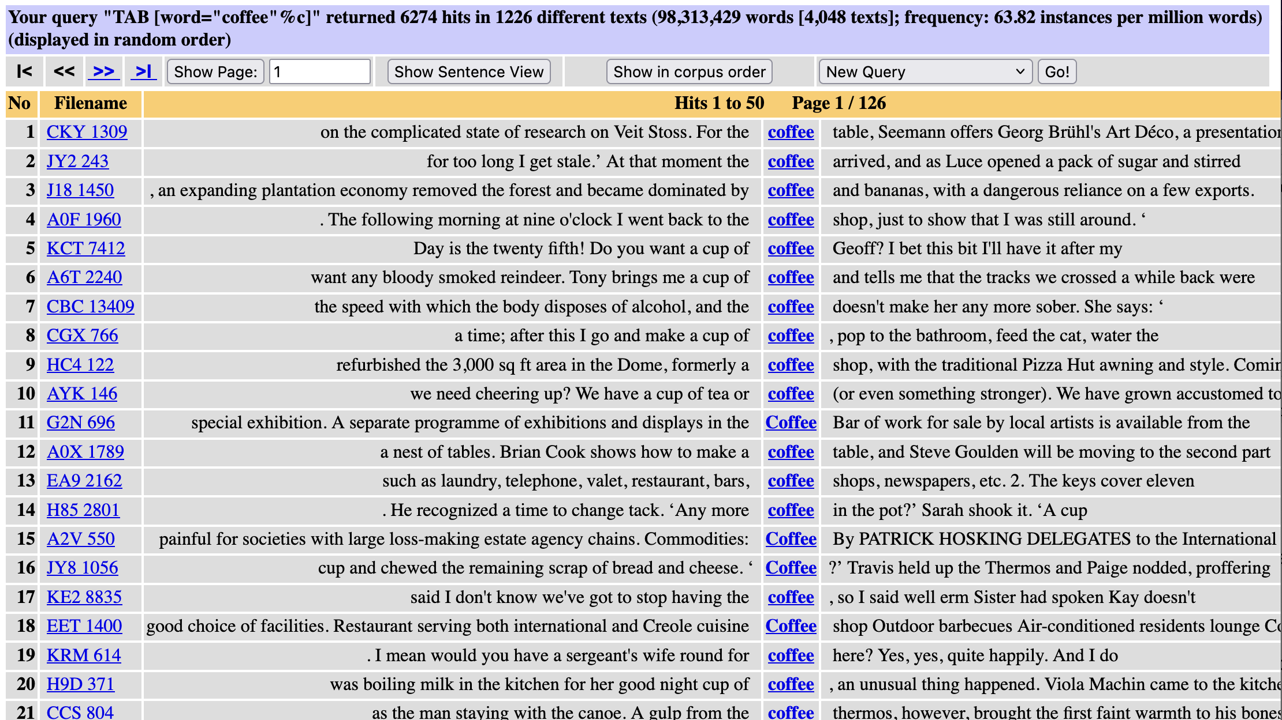

Slide 25
Orientation
What we have learned so far …
Concordances collect occurrences of a node for “vertical reading”
Help corpus linguistics detect recurrent patterns
But often not so easy to spot patterns in real-life concordances
What we're going to look at now …
How does software support reading concordances?
What general strategies are used to organise concordance lines?

Slide 26
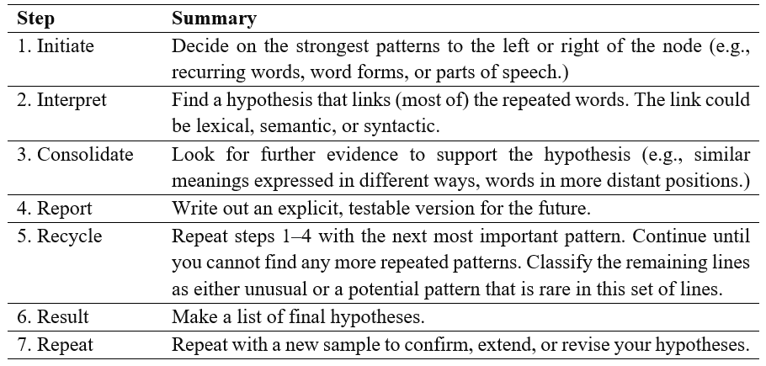
A conc. reading procedure (Sinclair 2003)

Slide 27
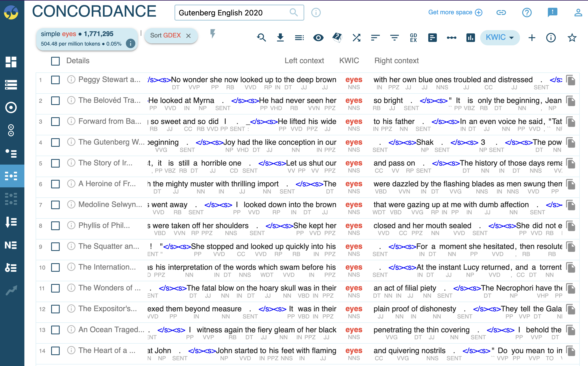
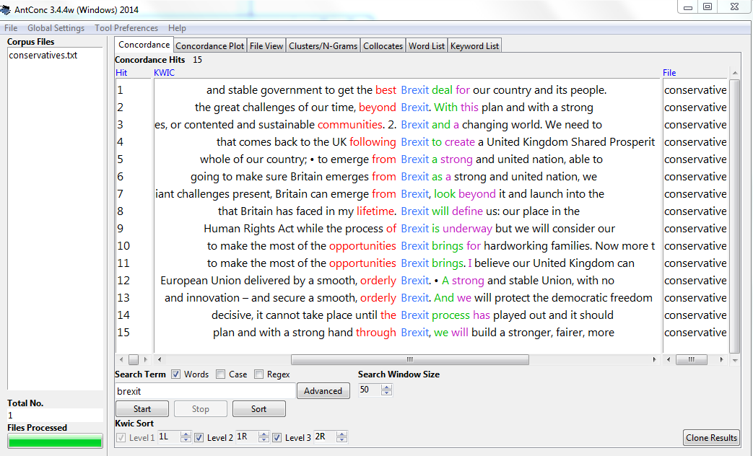
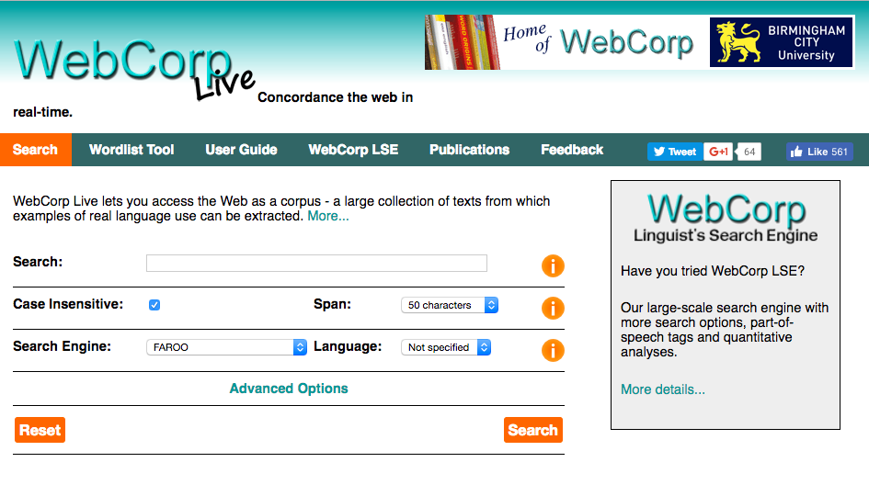
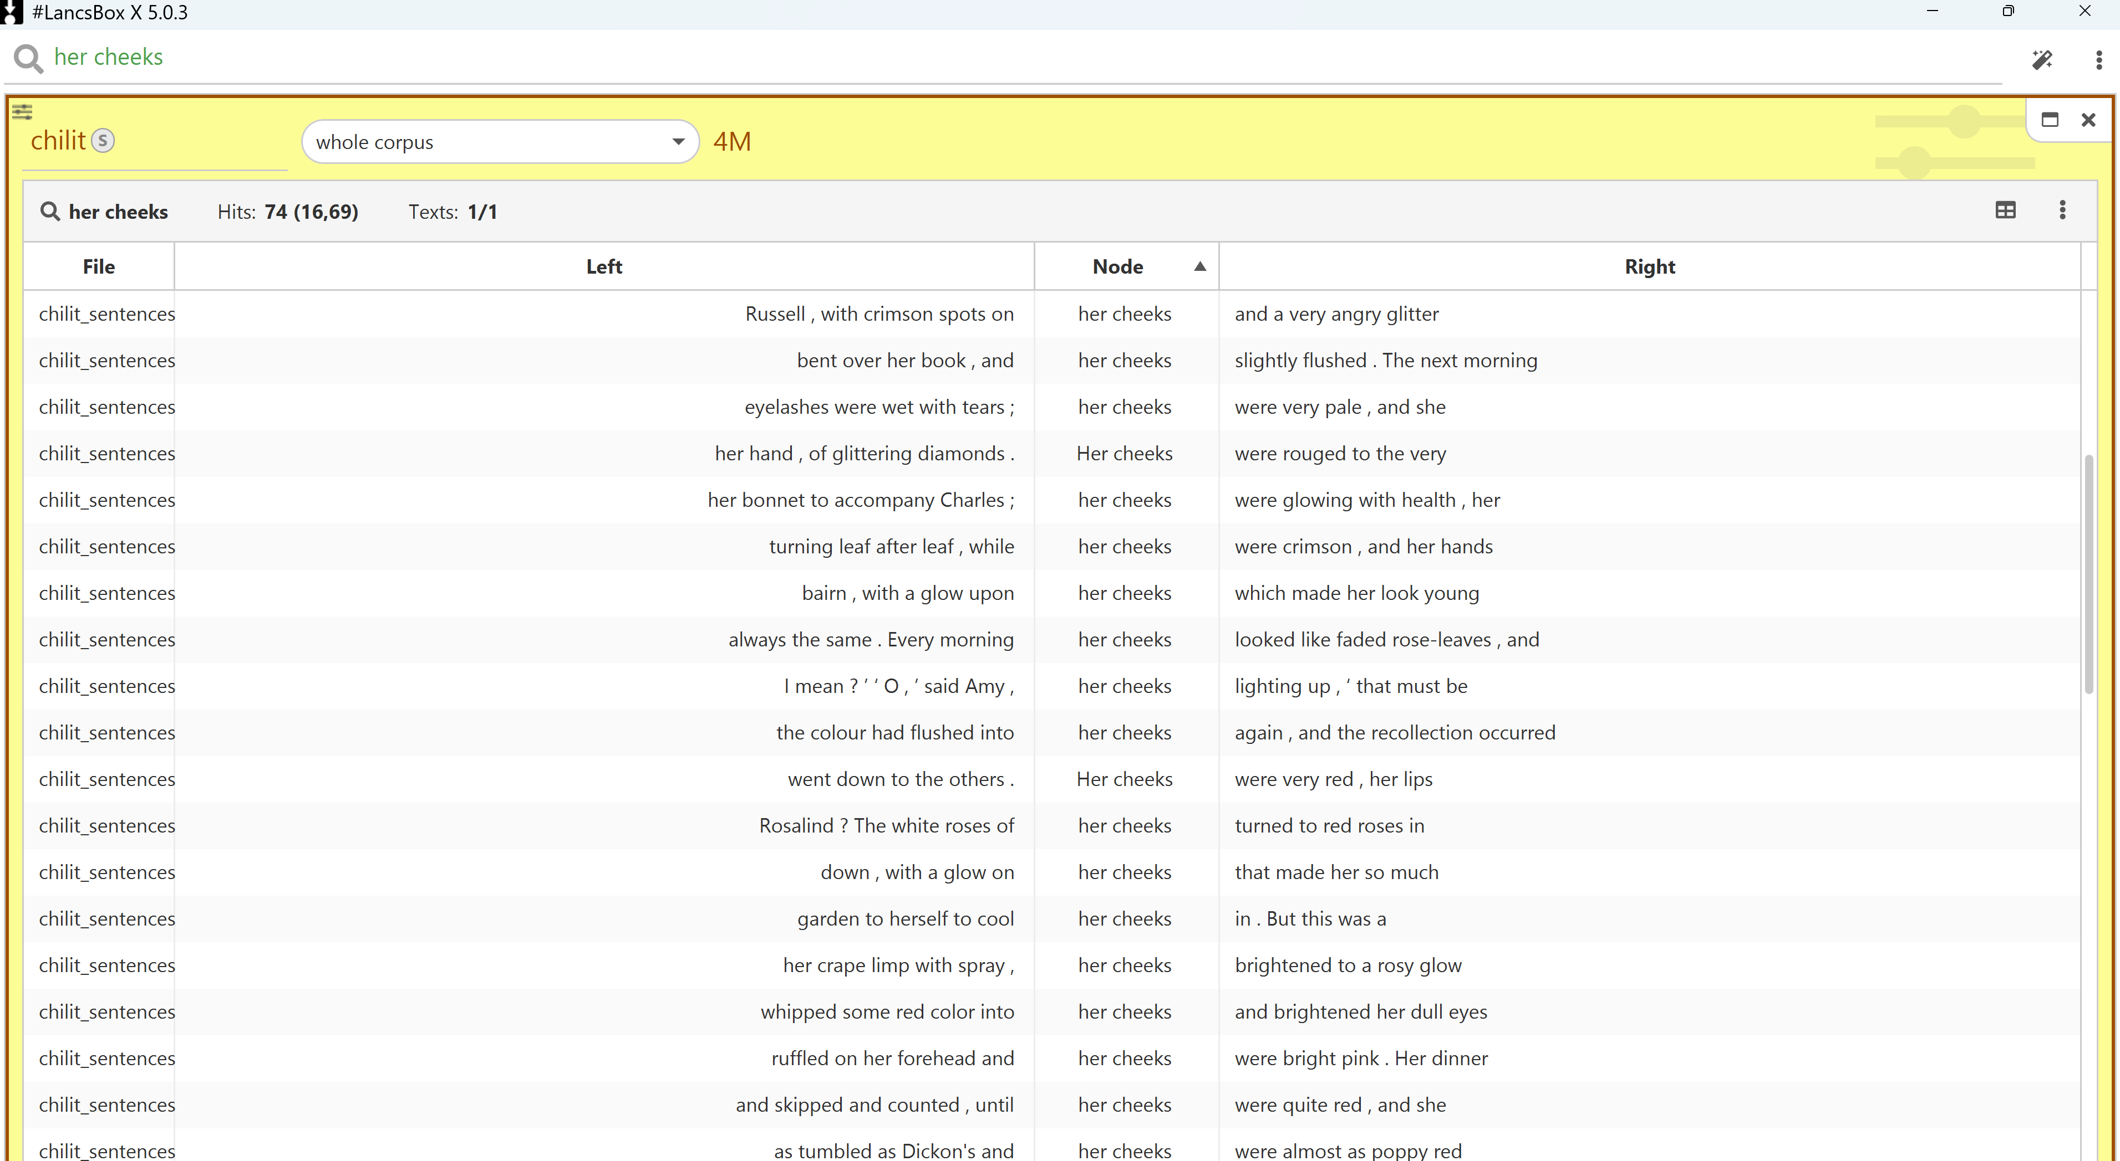
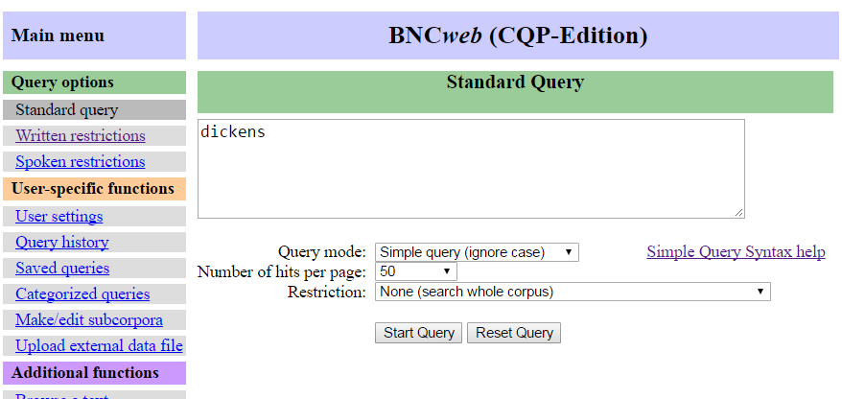
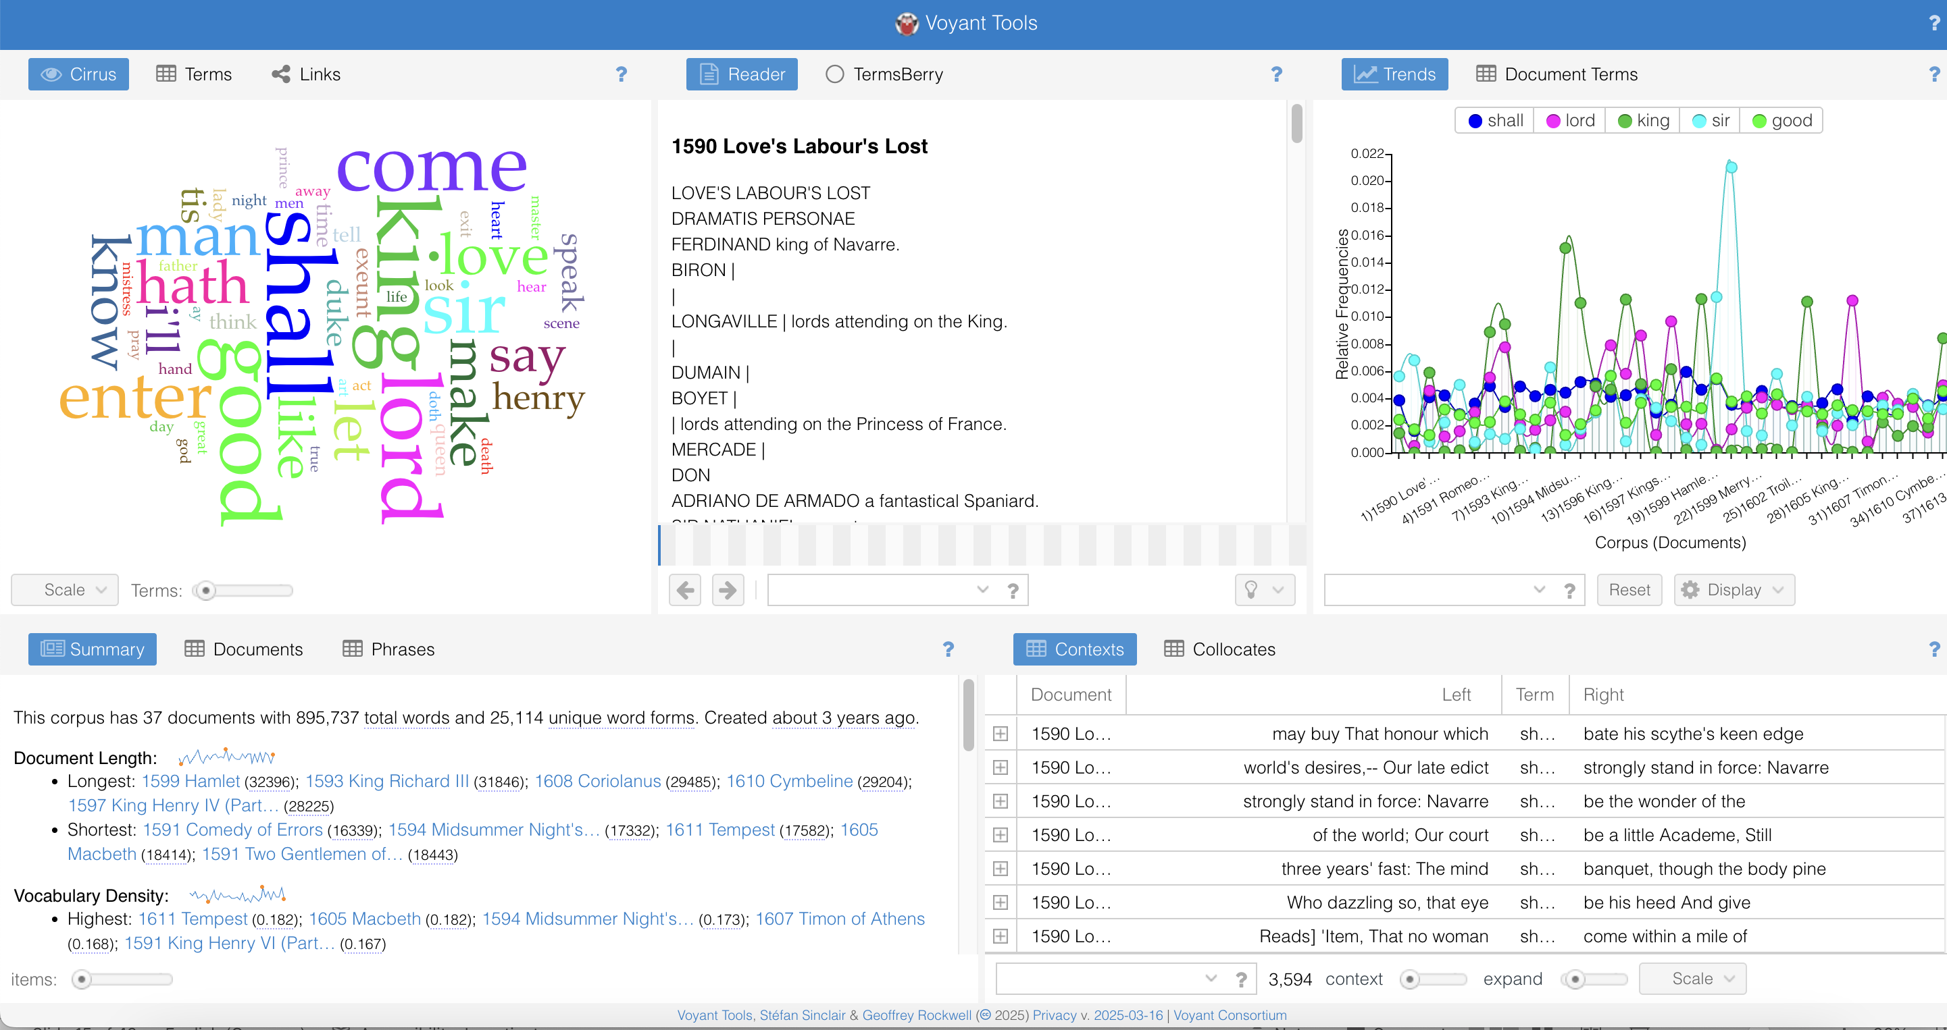
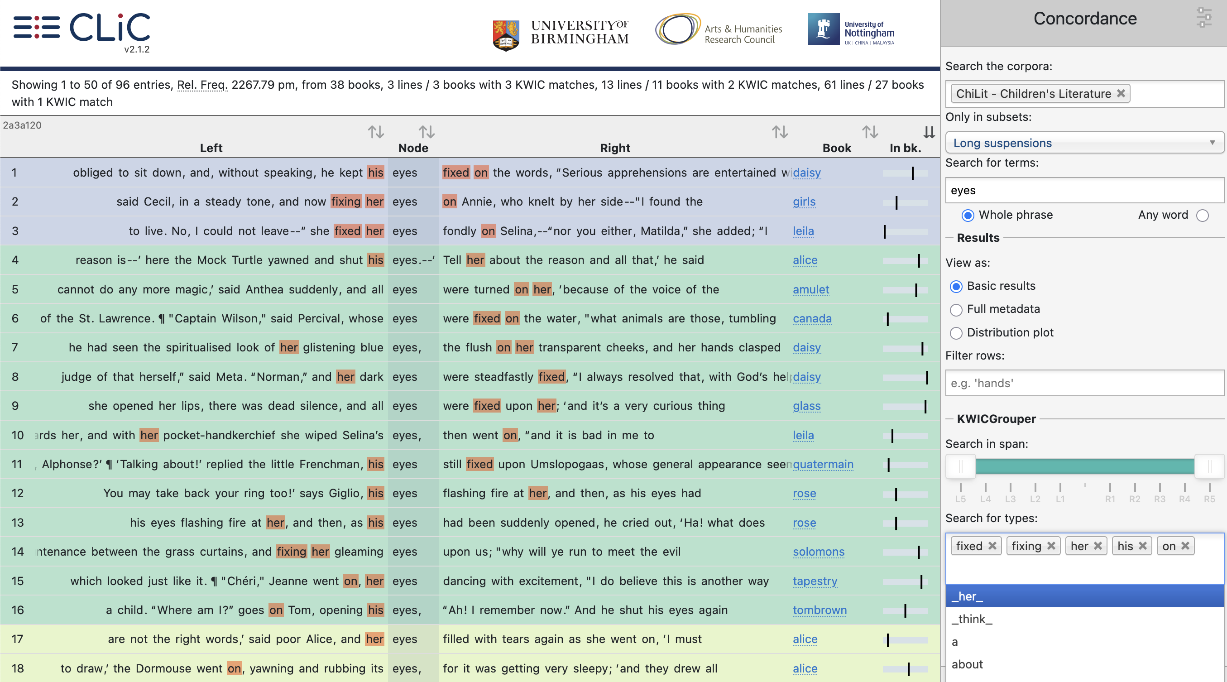
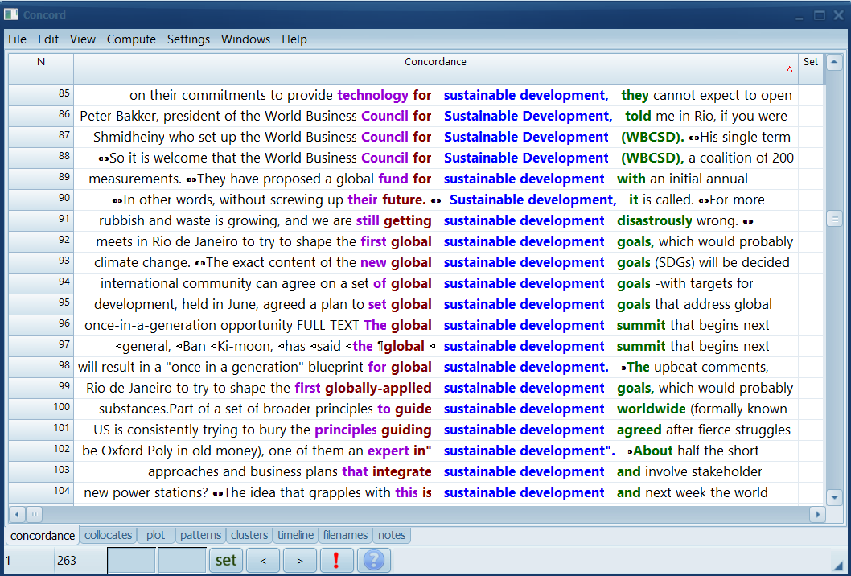
How can concordancing software help?

Slide 28
How can concordancing software help?

Slide 29
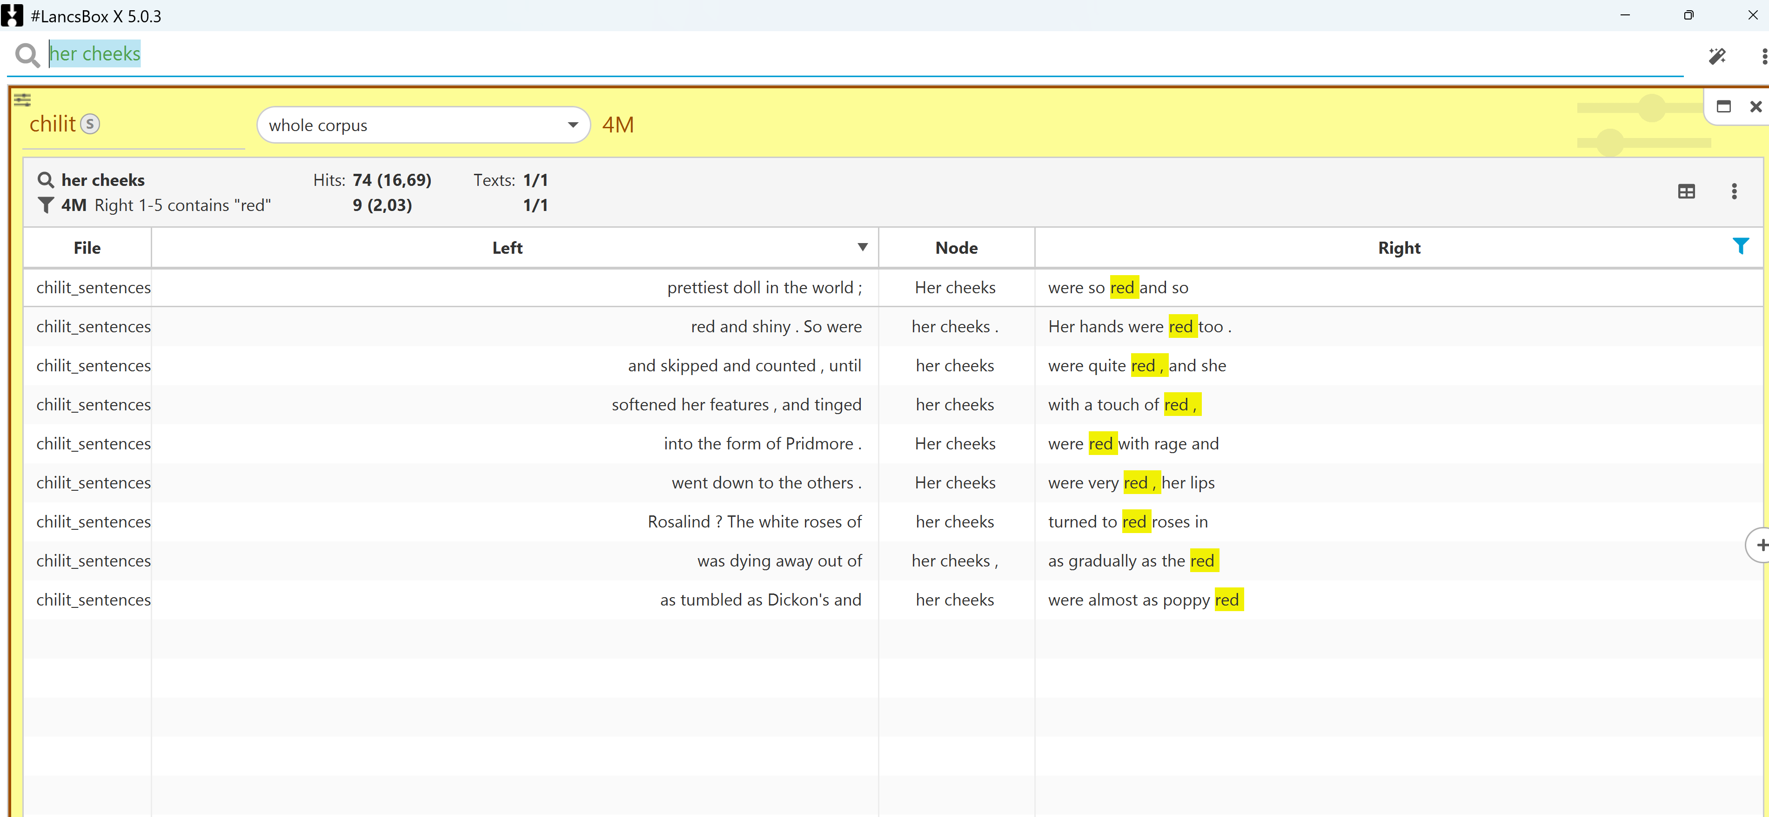
Select lines to “zoom in”

Slide 30
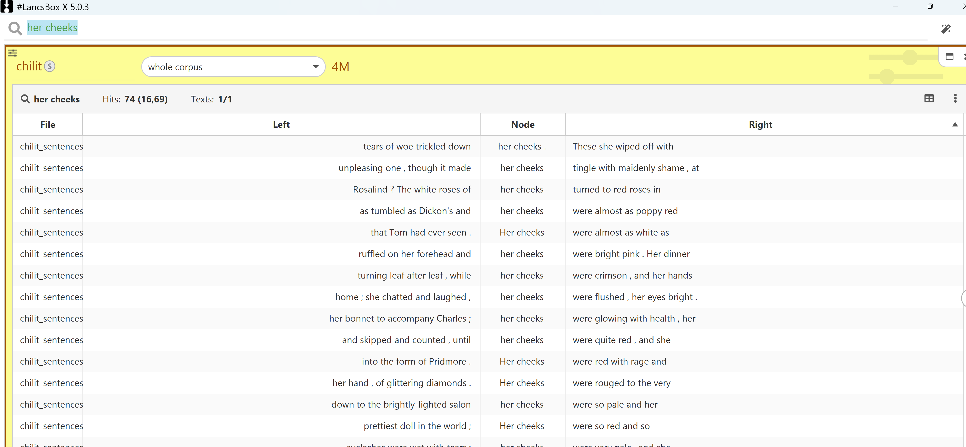
Sort lines (e.g. on right context)

Slide 31
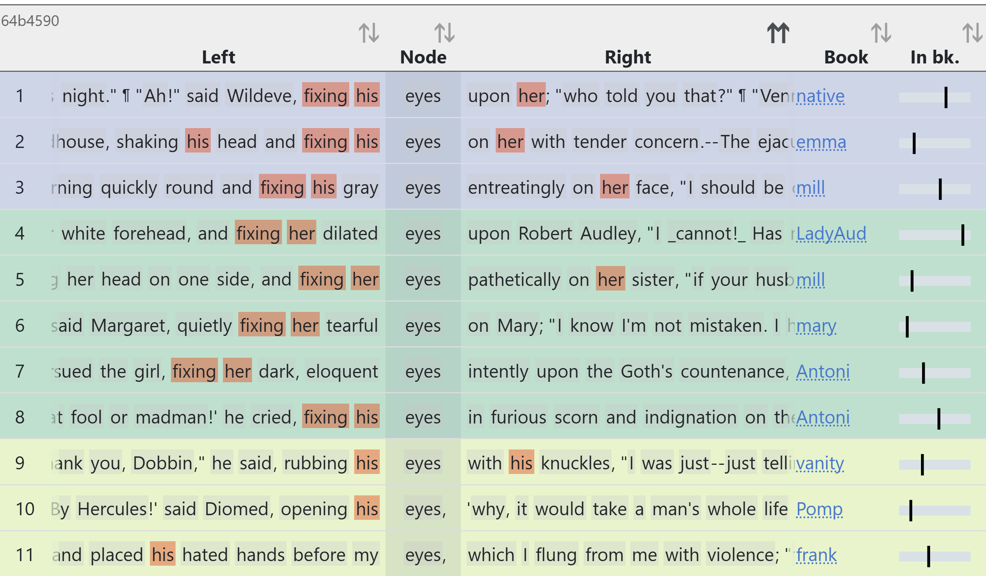
Rank lines with KWICgrouper
node: eyes in suspensions
KWICgrouped on keywords his, her, fixing
clic-fiction.com

Slide 32
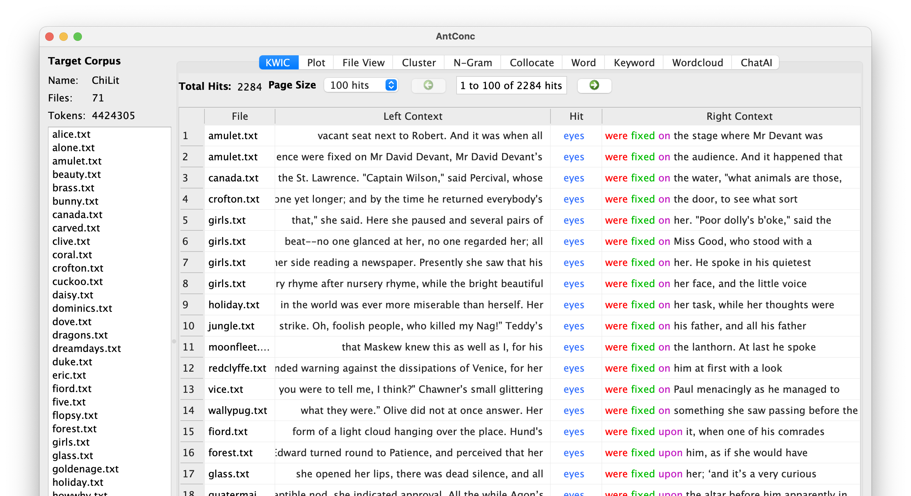
Sort by KWICpatterns

Slide 33

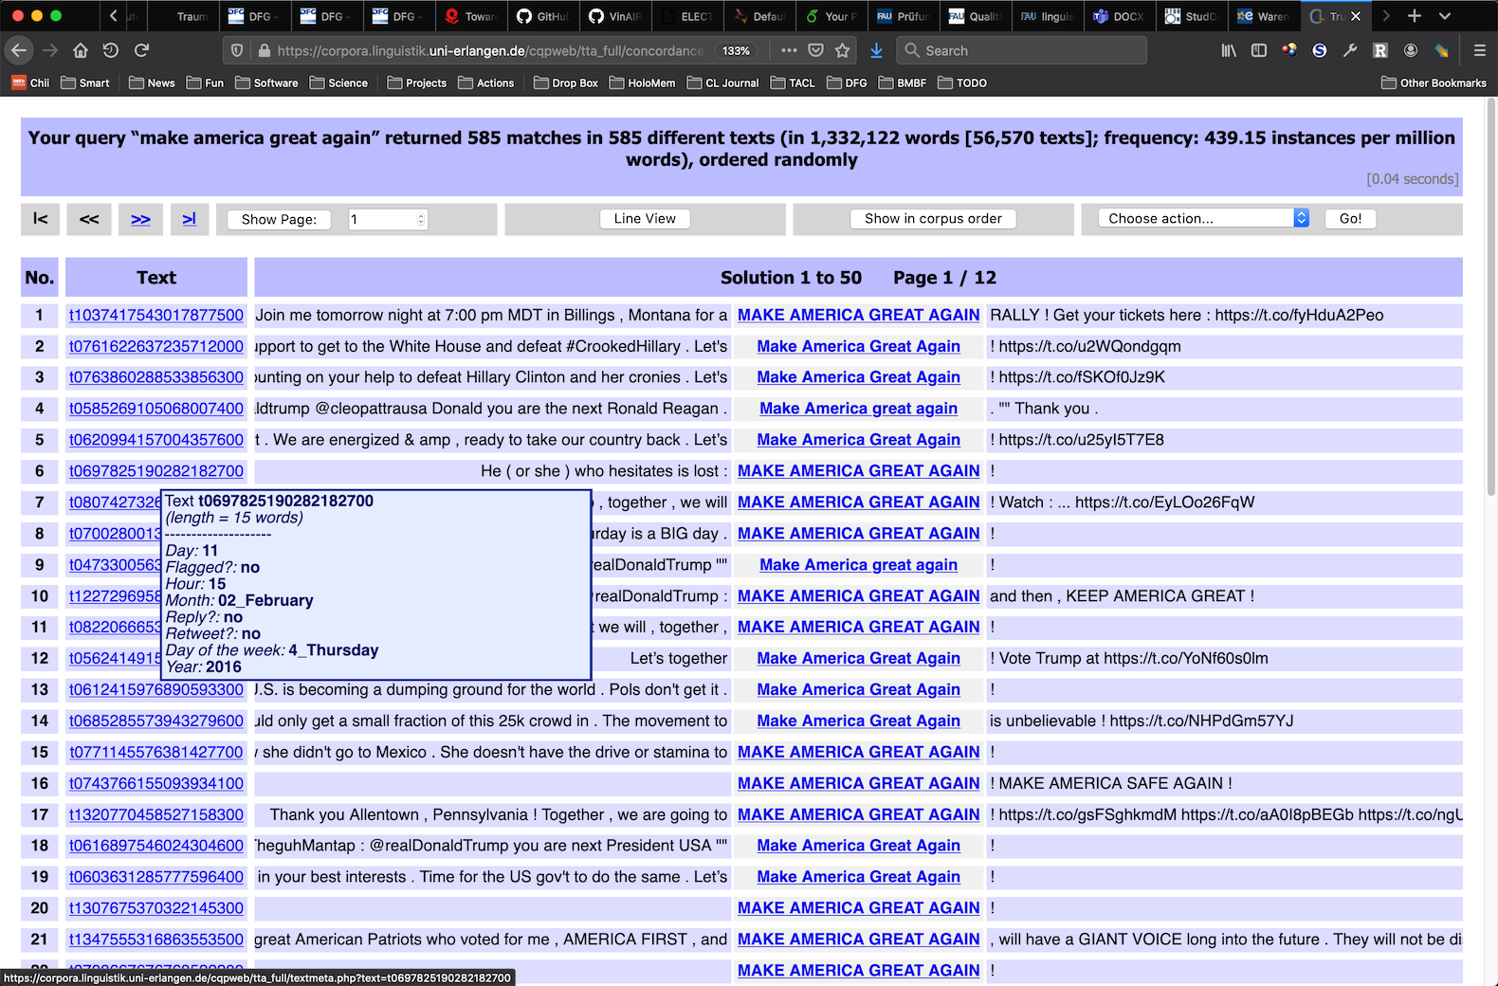
CQPweb: A hands-on example
Goal: Understand this [➞] guy's rhetoric, terminology, phraseology and topics
Based on corpus compiled from the Trump Twitter Archive [www.thetrumparchive.com]

Slide 34

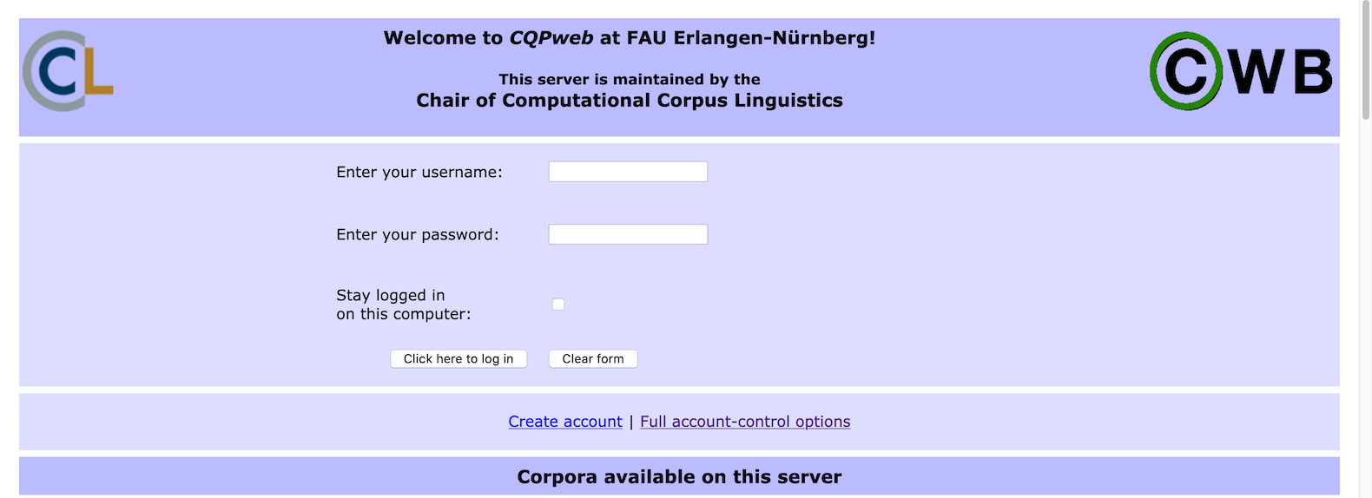
CQPweb: A hands-on example
CQPweb server @ FAU: https://corpora.linguistik.uni-erlangen.de/cqpweb/
Login: student1 … student15 | password: erlangen

Slide 35
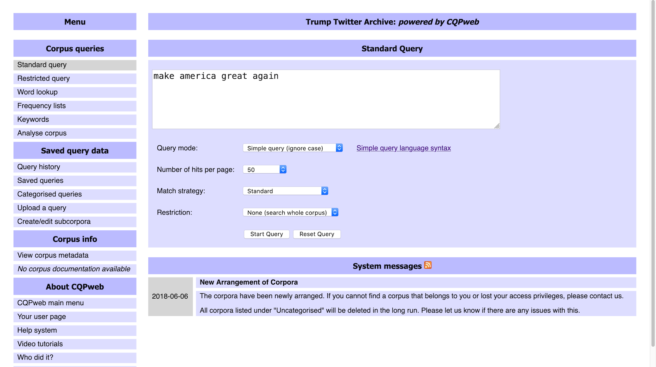
Simple search

Slide 36
Concordance (kwic = key word in context)
frequency information
random ordering
click for context
click / hover for metadata

Slide 37
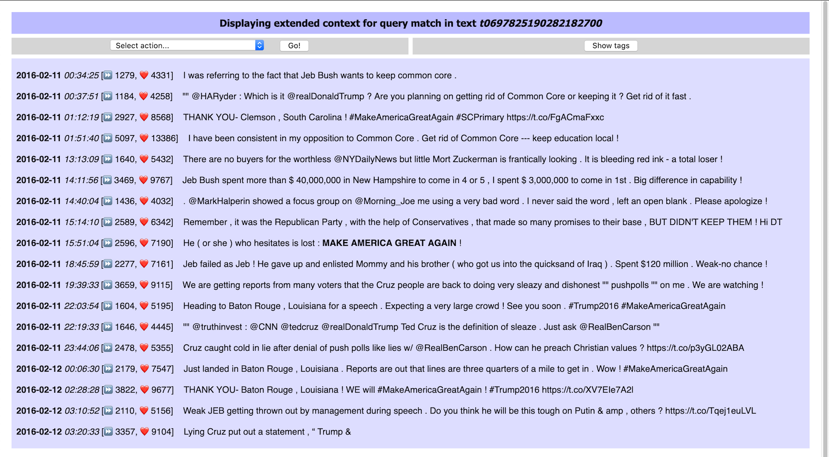
Extended context display with formatting
this is the match

Slide 38
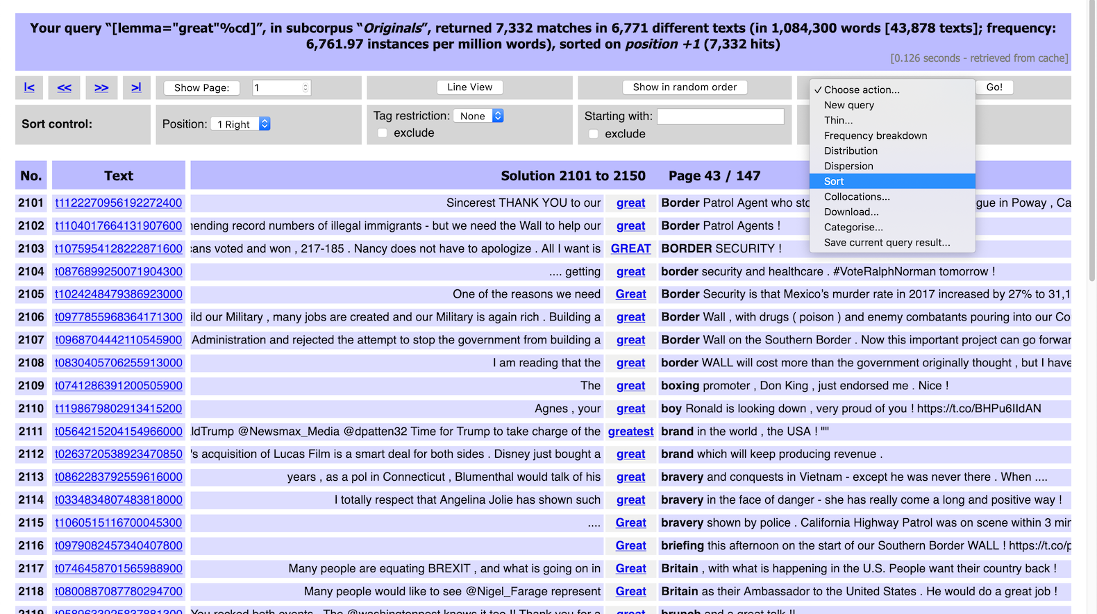
Sorted concordance: great
action menu

Slide 39
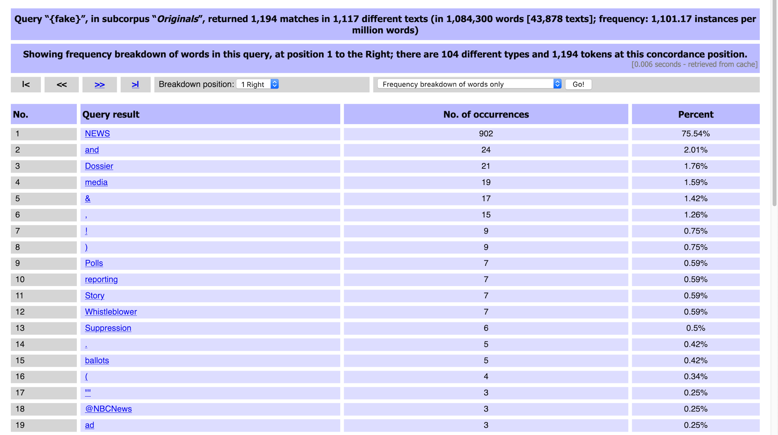
Frequency breakdown: fake
full process history

Slide 40
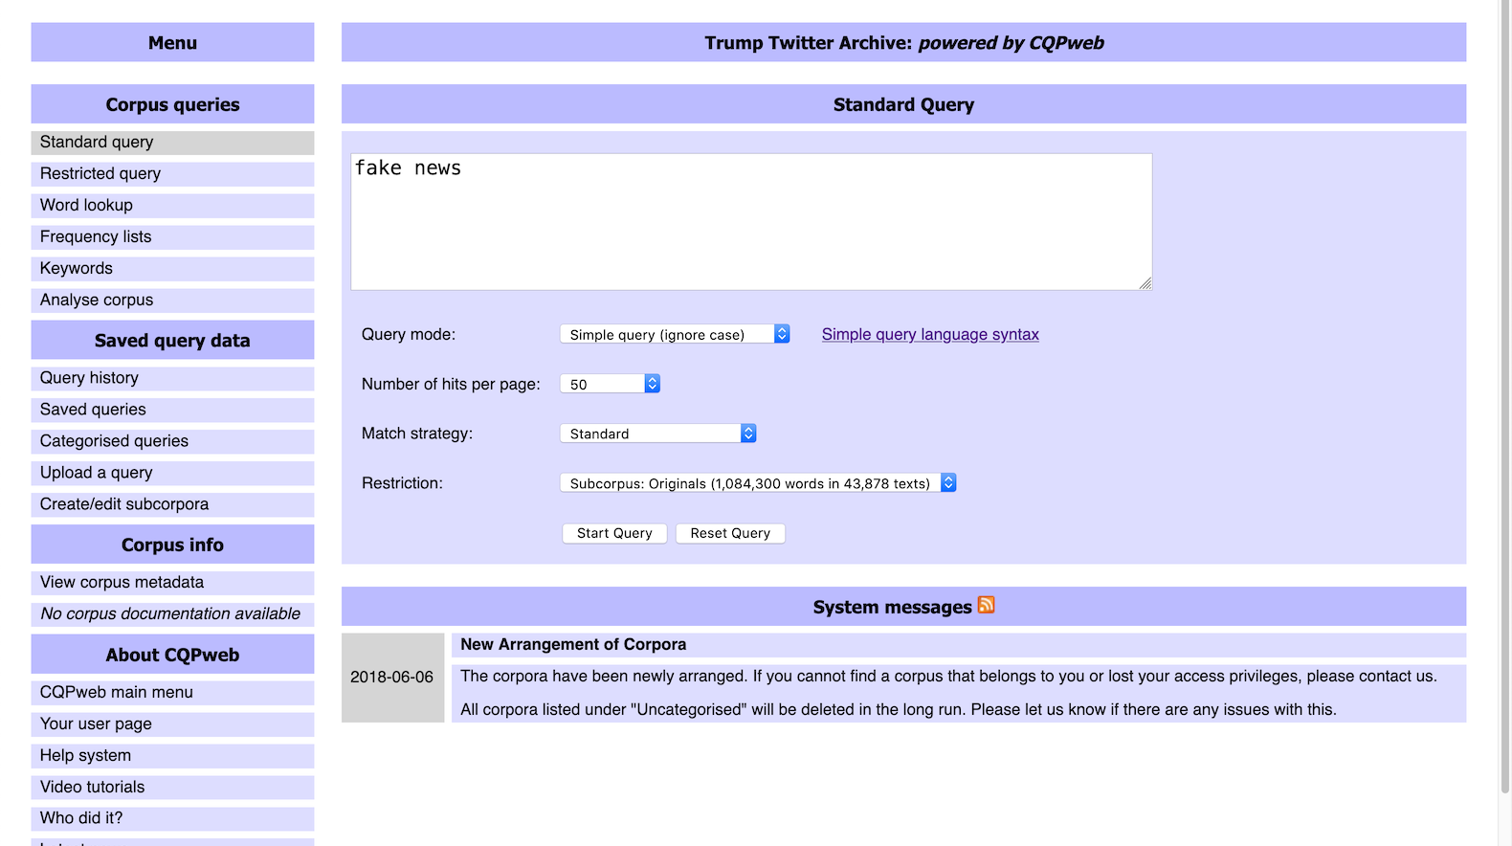
Time for a closer look: fake news

Slide 41
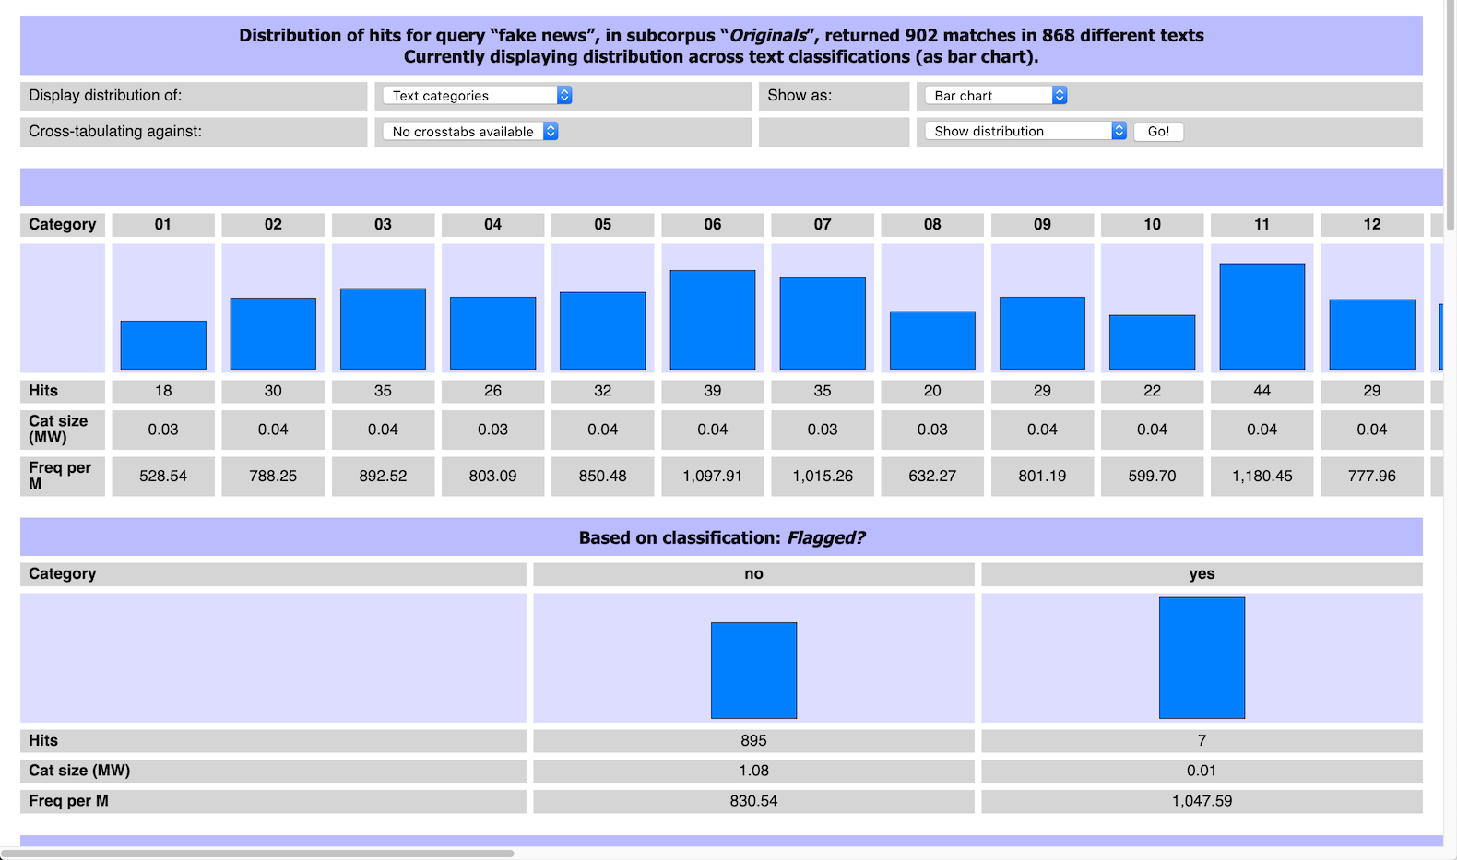
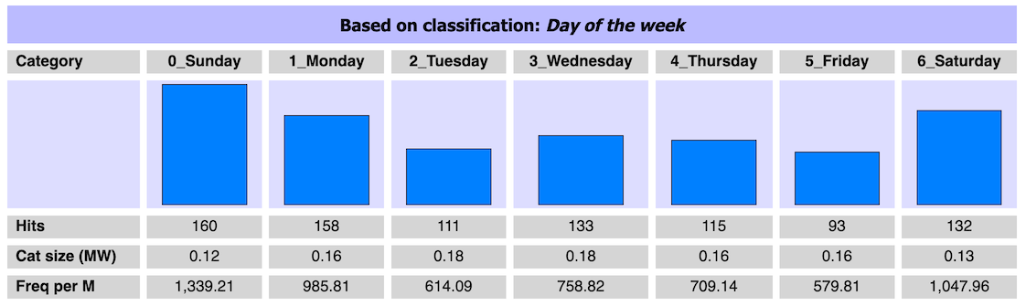
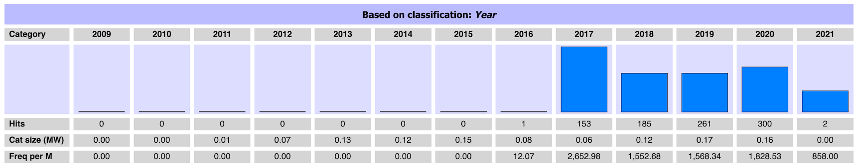
Distribution across metadata categories

Slide 42
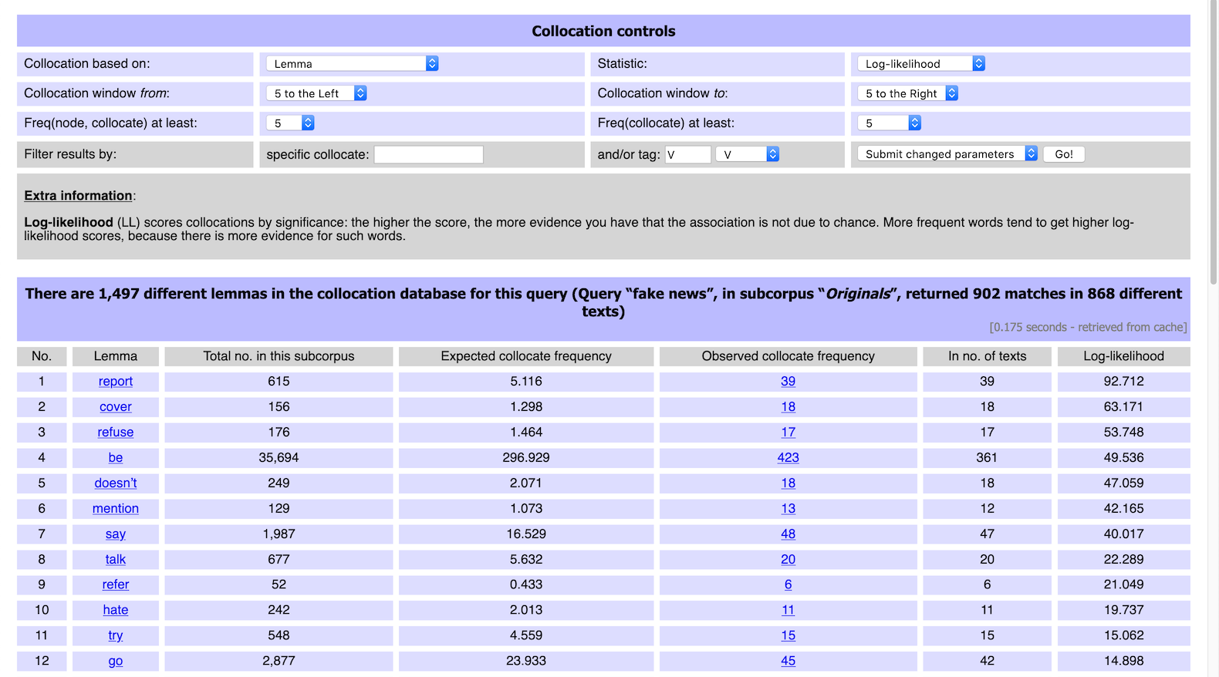
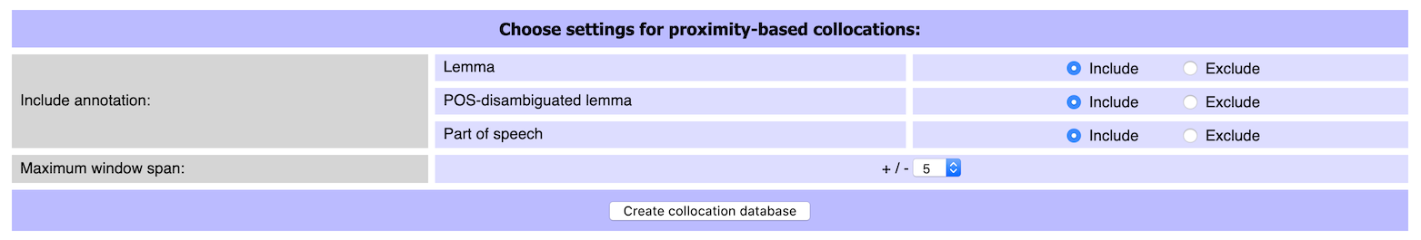
Collocation analysis
key parameters
click for examples

Slide 43
CQPweb exercise
Activate corpus ParlSpeech UK
corpus of debates of the UK parliament 1988–2019
Rauh, C. & Schwalbach, J. (2020). The ParlSpeech V2 data set: Full-text corpora of 6.3 million parliamentary speeches in the key legislative chambers of nine representative democracies. https://doi.org/10.7910/DVN/L4OAKN
~ 2 M turns with a total of ~ 400 M tokens
Concordance analysis for query: water and sanitation
what recurrent patterns can you identify?
can you find evidence for larger units of meaning?

Slide 44
Again: How can concordancing software help?
Most concordancing tools provide very similar functionality: kwic display (paged or scrollable), extended context view, random shuffle, sort by left/right context, filter by context words, frequency counts, metadata distribution, …
Not much innovation since first concordances (Sinclair 1966)
Each tool has one special gimmick (and new tool for each new idea)
#LancsBoxX: collocation graphs
AntConc: KWIC patterns
Sketch Engine: word sketches & sketch differences
We need a more systematic approach for true innovation!

Slide 45
Practices in different disciplines: strategies
10 articles / case studies per discipline (40 total)
Lexicography
Data-driven learning
Corpus-assisted discourse studies
Literary stylistics
post-2000 publication; concrete examples
not included: studies using parallel or learner corpora
Content analysis of methods sections (not literature review)
Challenge: no systematic standards for describing methodology, mix of tool and method
Notes:
How are these disciplines different, what do you expect?

Slide 46
Selecting
Sampling
A random sample of 100 concordances of each pair was, subsequently, closely examined for semantic prosody. (Lexicography)
Filtering
A concordance query for carry out with research in the context of three tokens to the left and to the right returned 160 hits, and most lines indeed exhibited the collocation carry out research, as exemplified in Figure 8, …. (Lexicography)

Slide 47
Selecting
Cleaning
As we were interested in lexical compounds linked to carbon dioxide rather than carbon as an element, such lexical combinations as, for example, carbon molecule or carbon fibre were removed. Nonsensical combinations as well as duplicates arising from differences in spelling such as carbon offset and carbon-offset were also eliminated. (CADS)
Threshold
We analysed the first 500 concordances of seguire chosen as “good examples” by the Sketch Engine (cf. Kilgarriff et al., 2008) (Lexicography)

Slide 48
Ordering
Sorting
WordSmith Tools was mainly used for sorting and categorising concordances because it allows the analyst to assign values to lines and to move easily from concordance to text. [Figure 3 shows sorting by 1R] (CADS)
The students were then instructed to search for the preceding underlined word friendship using IntelliText, and to examine the concordance lines to identify which preposition should follow friendship in this context, by sorting right or left contexts in keyword-in-context (KWIC) lines. (DDL)

Slide 49
Ordering
Ranking
We analysed the first 500 concordances of seguire chosen as “good examples” by the Sketch Engine (cf. Kilgarriff et al., 2008) (Lexicography)

Slide 50
Grouping
collocations … established manually through sorted concordances
the researcher is normally required to analyse hundreds of lines of concordance data by hand, in order to identify wider themes or patterns in the corpus which are not so easily spotted via collocation, key word or frequency analysis. The analyst then has to make sense of the linguistic patterns thrown up via the corpus-based processes, usually with reference to one or more theoretical frameworks
close analysis of expanded concordances (or whole texts, when necessary) revealed ….
(CADS)

Slide 51
Orientation
What we have learned so far …
Reading concordances with (and without) the help of software tools
How to identify recurrent patterns and interpret them
Strategies and algorithms for organising concordance lines
What we're going to look at now …
A mathematical framework for reading concordances with algorithms
What further algorithms could be useful?
How can we document the concordance reading process?

Slide 52
Our goal
Goal: Develop mathematical framework for computational algorithms used to organise concordance lines in the concordance reading process.
Tightly connected to kwic-style display of concordance lines
Limitation: only algorithms that can be understood as a rearrangement of concordance lines ➞ makes generic UI possible
Focus on three main general strategies in current practice

Slide 53
But why?
Why not just invent some really cool new algorithms and implement them in #FAUbox or EverConc?

Slide 54
But why?
Community needs general framework, not another app
Make novel algorithms available in many (all) concordancers
Specify precise semantics of algorithms
Combining algorithms: limitations
Consistent visualisation in UI
Formal model of organising concordances
Research documentation

Slide 55
Concordance reading strategies
Selecting
Ordering
Sorting / Ranking
Grouping
Partitioning/Clustering

Slide 56
From strategies to algorithms
Selecting
“zoom in” on a subset of the concordance lines
either focus on specific pattern or discard unwanted lines
Ordering
change sequential ordering of concordance lines in the display
may want to combine multiple ordering criteria to break ties
Grouping
form groups of related concordance lines
requires structured kwic display in UI

Slide 57
From strategies to algorithms
Selecting
“zoom in” on a subset of the concordance lines
either focus on specific pattern or discard unwanted lines
Ordering
Sorting: reorder lines based on pairwise comparison
Ranking: reorder lines based on preference score
combine multiple Sorting and Ranking algorithms to break ties
Grouping
form groups of related concordance lines
requires structured kwic display in UI

Slide 58
From strategies to algorithms
Selecting
“zoom in” on a subset of the concordance lines
either focus on specific pattern or discard unwanted lines
Ordering
Sorting: reorder lines based on pairwise comparison
Ranking: reorder lines based on preference score
combine multiple Sorting and Ranking algorithms to break ties
Grouping
Partitioning: groups based on common property
Clustering: (nested) groups based on pairwise similarity
requires structured kwic display in UI

Slide 59
Combining algorithms
Selecting
“zoom in” on a subset of the concordance lines
either focus on specific pattern or discard unwanted lines
Ordering
Sorting: reorder lines based on pairwise comparison
Ranking: reorder lines based on preference score
combine multiple Sorting and Ranking algorithms to break ties
Grouping
Partitioning: groups based on common property
Clustering: (nested) groups based on pairwise similarity
requires structured kwic display in UI
subset
arrangement

Slide 60


The analysis tree
Our model of concordance reading: analysis tree
Selecting creates branches that “zoom in” on a subset of lines ➞ subset node
investigate different patterns with each branch
turns history of operations into a hierarchical tree structure
Ordering and Grouping algorithms change how this subset is displayed to the analyst ➞ arrangement node
different arrangements of the same subset are siblings in the tree
default arrangement: original corpus order
Each node corresponds to a concordance view

Slide 61
Combining algorithms
Subset operations can be applied in parallel or nested
consecutively narrow down to smaller subsets ➞ structure of tree
Arrangement operations form alternative views of a subset
consequence: can't “stack” multiple arrangements
combine sequence of Ordering algorithms as tie-breakers
multiple Grouping algorithms cannot (or should not) be combined
Arrangement node = ≤ 1 Grouping + sequence of Ordering algo's
Grouping determines main structure, Ordering applies within groups

Slide 62
DNOV-CWB
Corpus
"eyes" %c
Query
Analysis Tree
Partition / Cluster ▼
⨁
Make selection ▼
🎔 Bookmark
Welcome to CandyConc
images do not represent actual gameplay

Slide 63
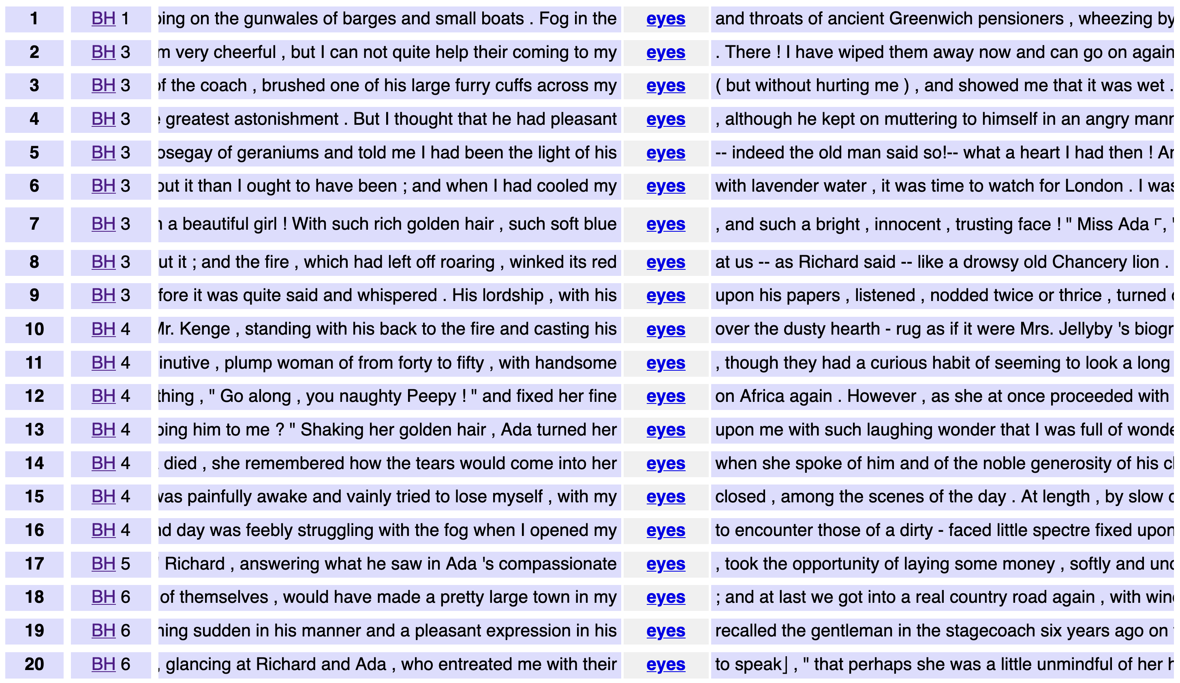
DNOV-CWB
Corpus
"eyes" %c
Query
root node
Partition / Cluster ▼
Analysis Tree
Query result (4031)
⨁
Make selection ▼
🎔 Bookmark
images do not represent actual gameplay

Slide 64
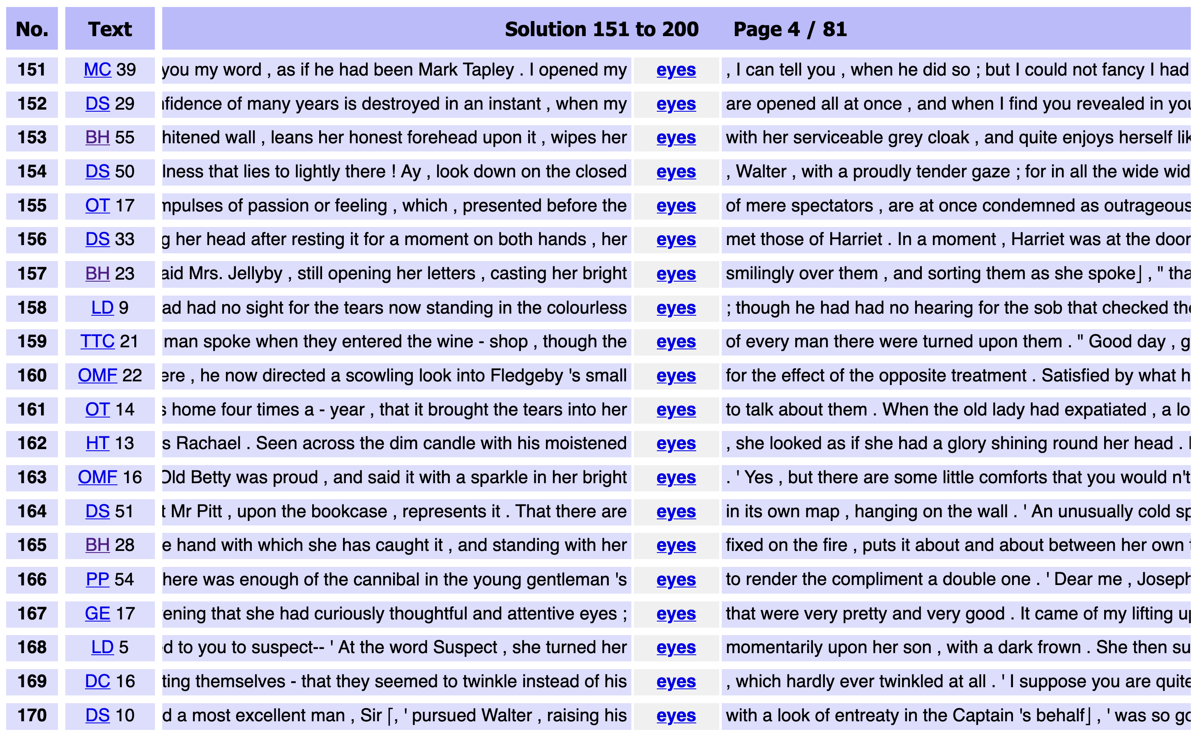
DNOV-CWB
Corpus
"eyes" %c
Query
root node
Partition / Cluster ▼
Analysis Tree
Sort
⨁
arrangement node
random ❎
Query result (4031)
• sort: random
Make selection ▼
🎔 Bookmark
images do not represent actual gameplay

Slide 65
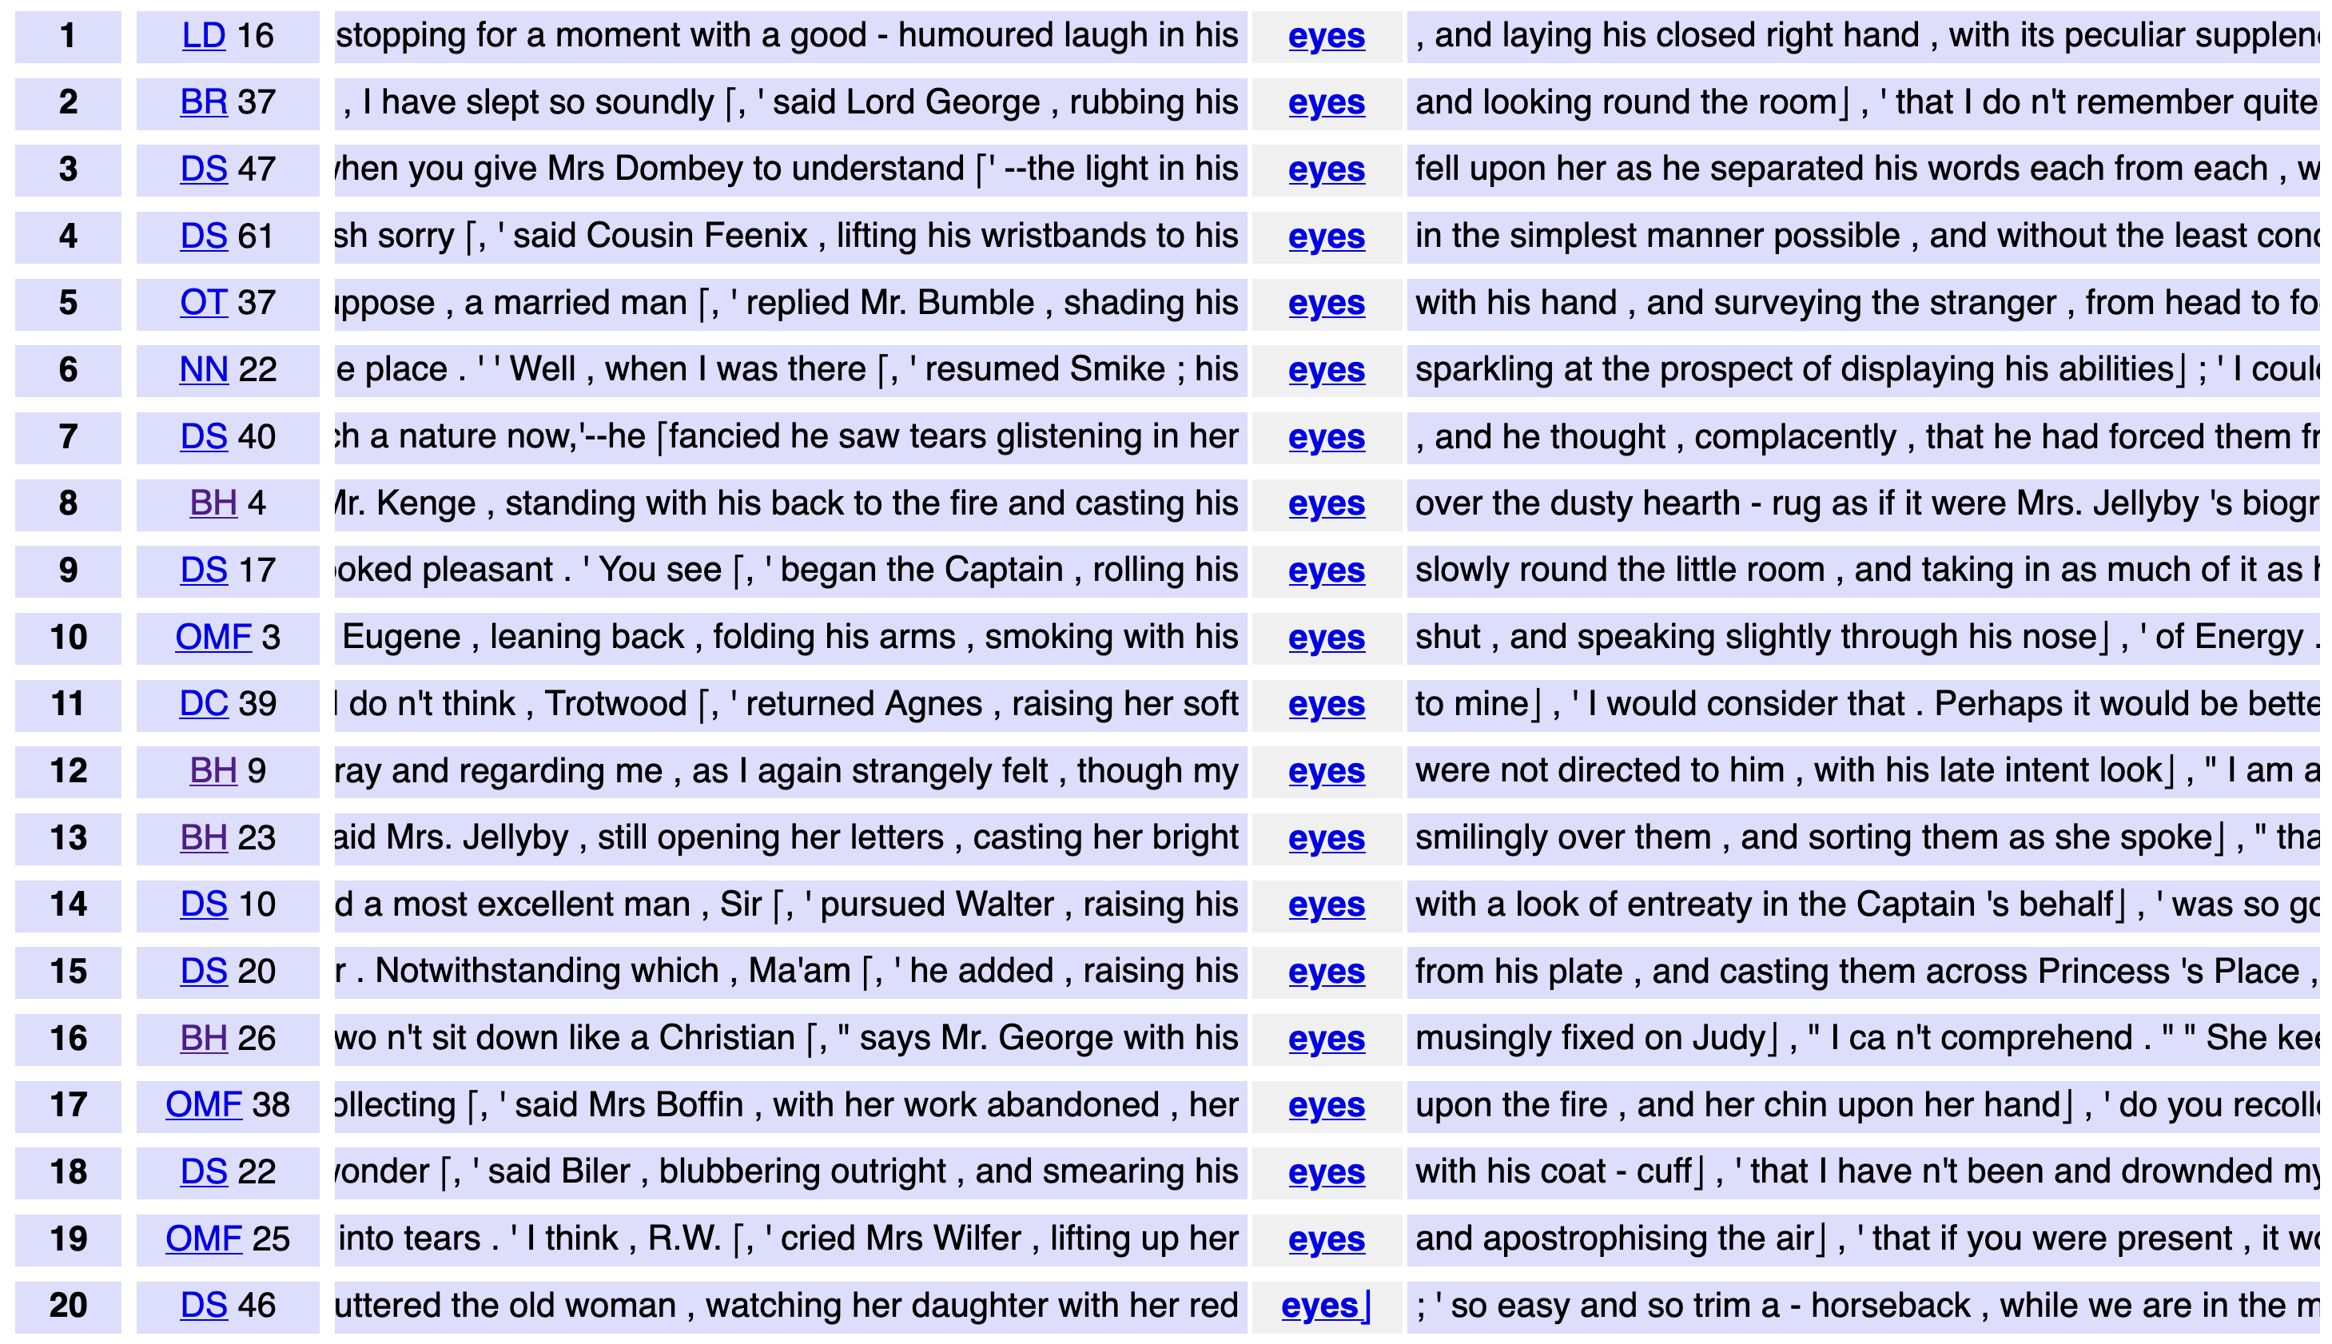
DNOV-CWB
Corpus
"eyes" %c
Query
root node
Partition / Cluster ▼
Analysis Tree
Sort
⨁
arrangement node
random ❎
Query result (4031)
▸ sort: random
• select: within suspension (276)
Make selection ▼
🎔 Bookmark
subset node
images do not represent actual gameplay

Slide 66
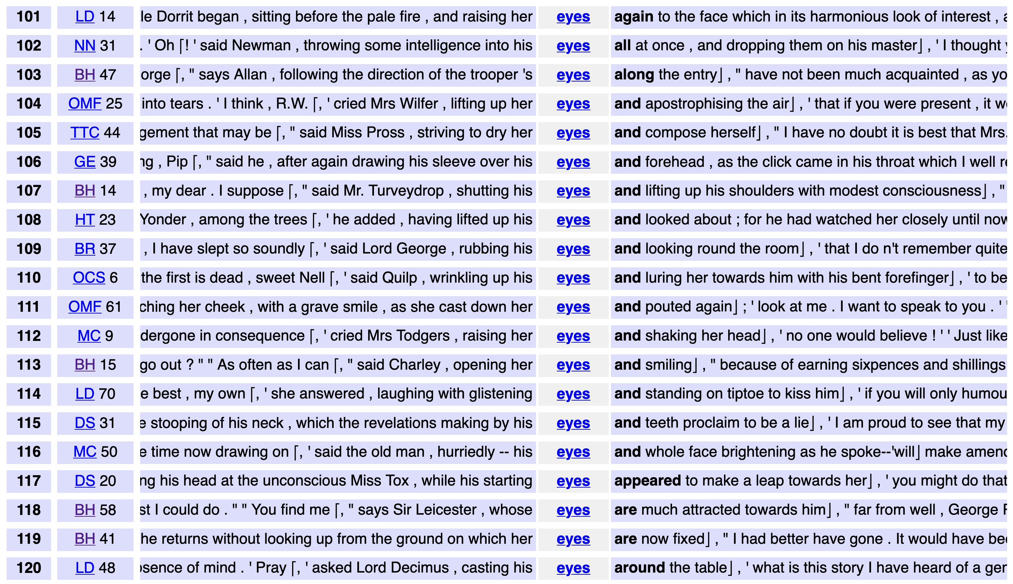
DNOV-CWB
Corpus
"eyes" %c
Query
root node
Partition / Cluster ▼
Analysis Tree
by right context ❎
⨁
arrangement node
Sort
Query result (4031)
▸ sort: random
▸ select: within suspension (276)
• sort: right context
Make selection ▼
🎔 Bookmark
subset node
images do not represent actual gameplay

Slide 67
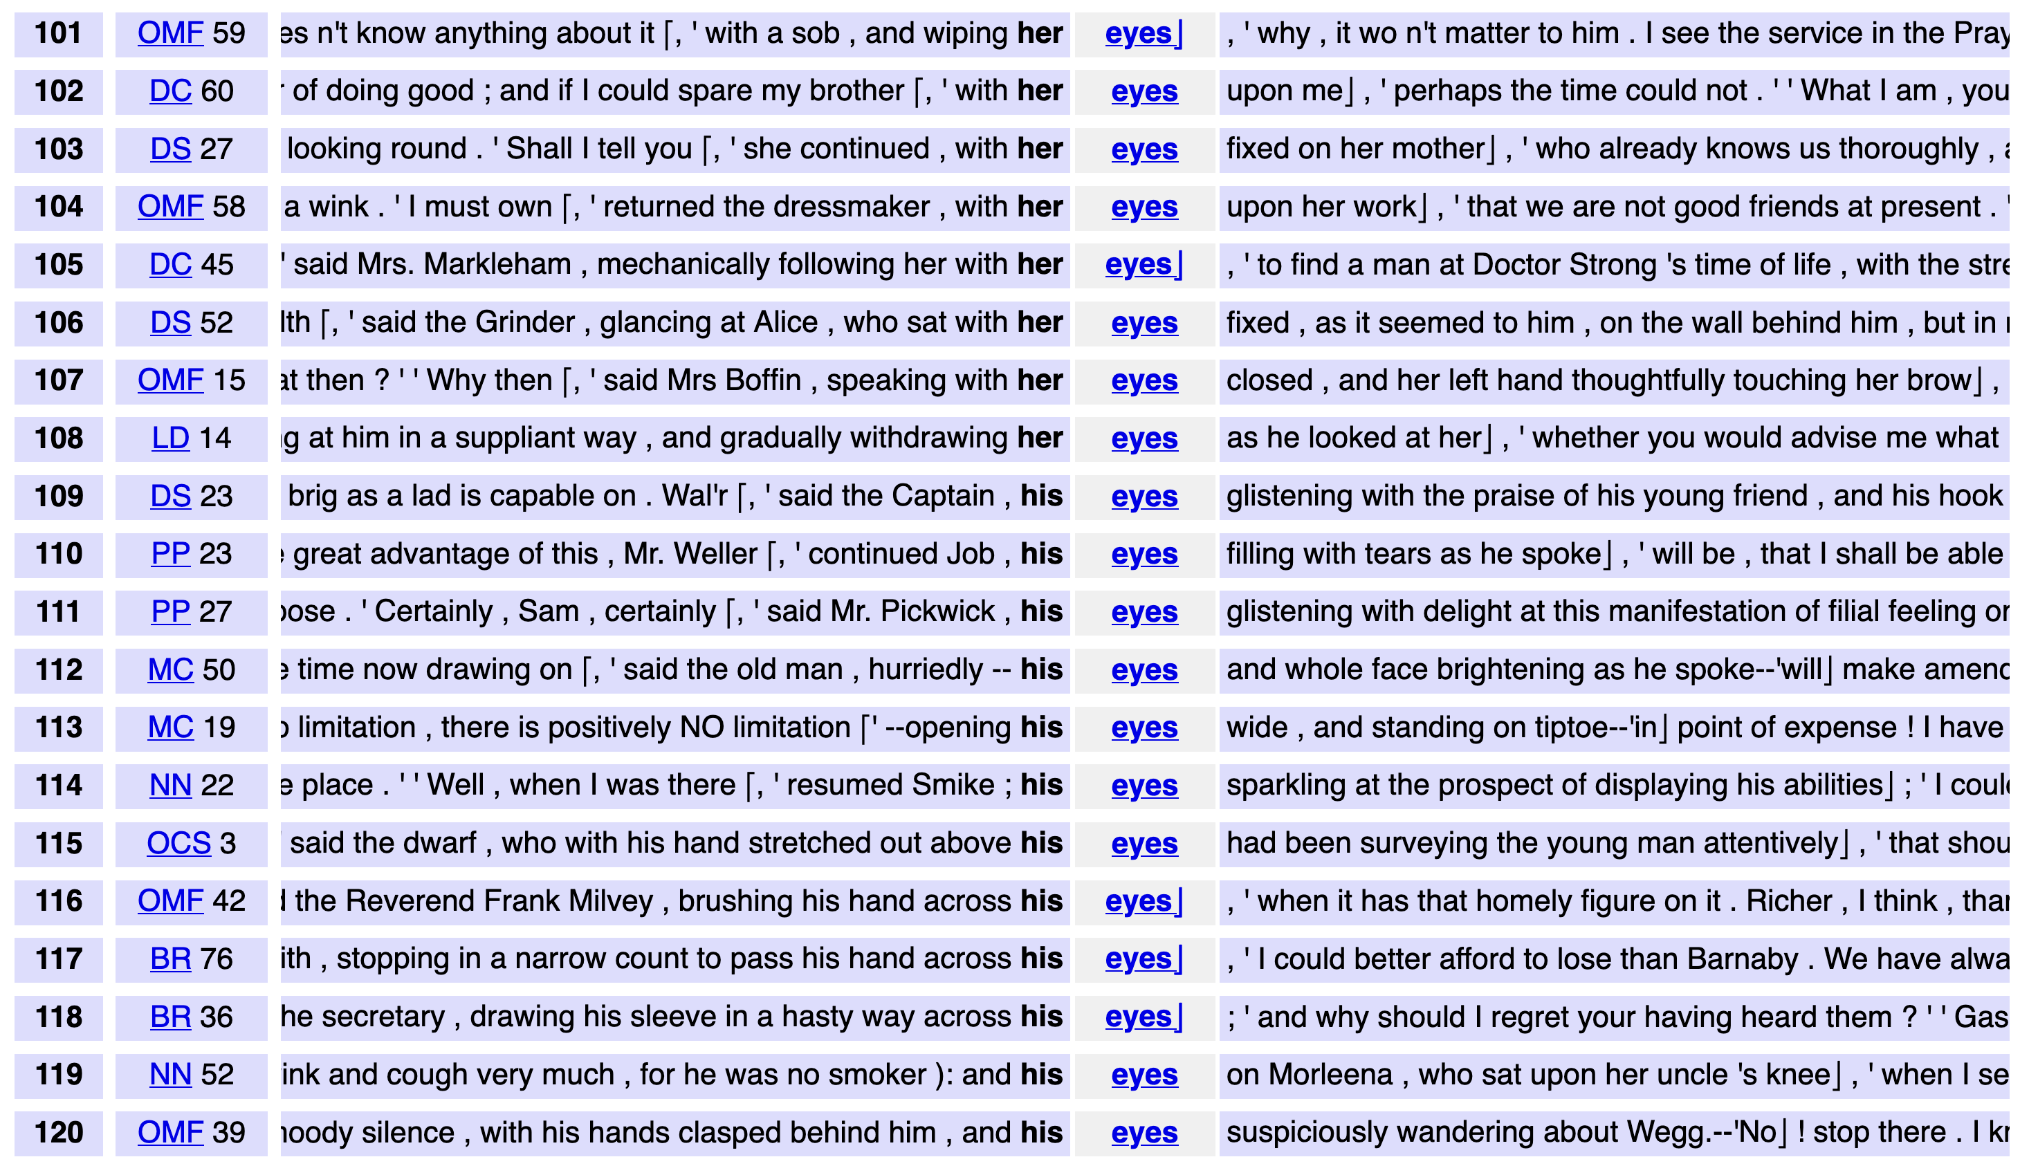
DNOV-CWB
Corpus
"eyes" %c
Query
root node
Partition / Cluster ▼
Analysis Tree
by left context ❎
⨁
arrangement node
Sort
Query result (4031)
▸ sort: random
▸ select: within suspension (276)
• sort: right context
• sort: left context
Make selection ▼
🎔 Bookmark
siblings
subset node
images do not represent actual gameplay

Slide 68
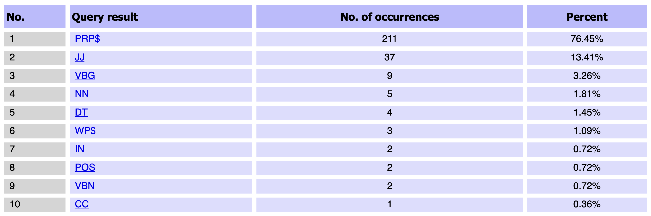
DNOV-CWB
Corpus
"eyes" %c
Query
root node
partition by POS tag of token L1
Analysis Tree
Partition / Cluster ▼
by left context ❎
⨁
arrangement node
Sort
Query result (4031)
▸ sort: random
▸ select: within suspension (276)
• sort: right context
• sort: left context
• partition: by POS tag @ L1, sort: left context
Make selection ▼
🎔 Bookmark
siblings
subset node
images do not represent actual gameplay

Slide 69
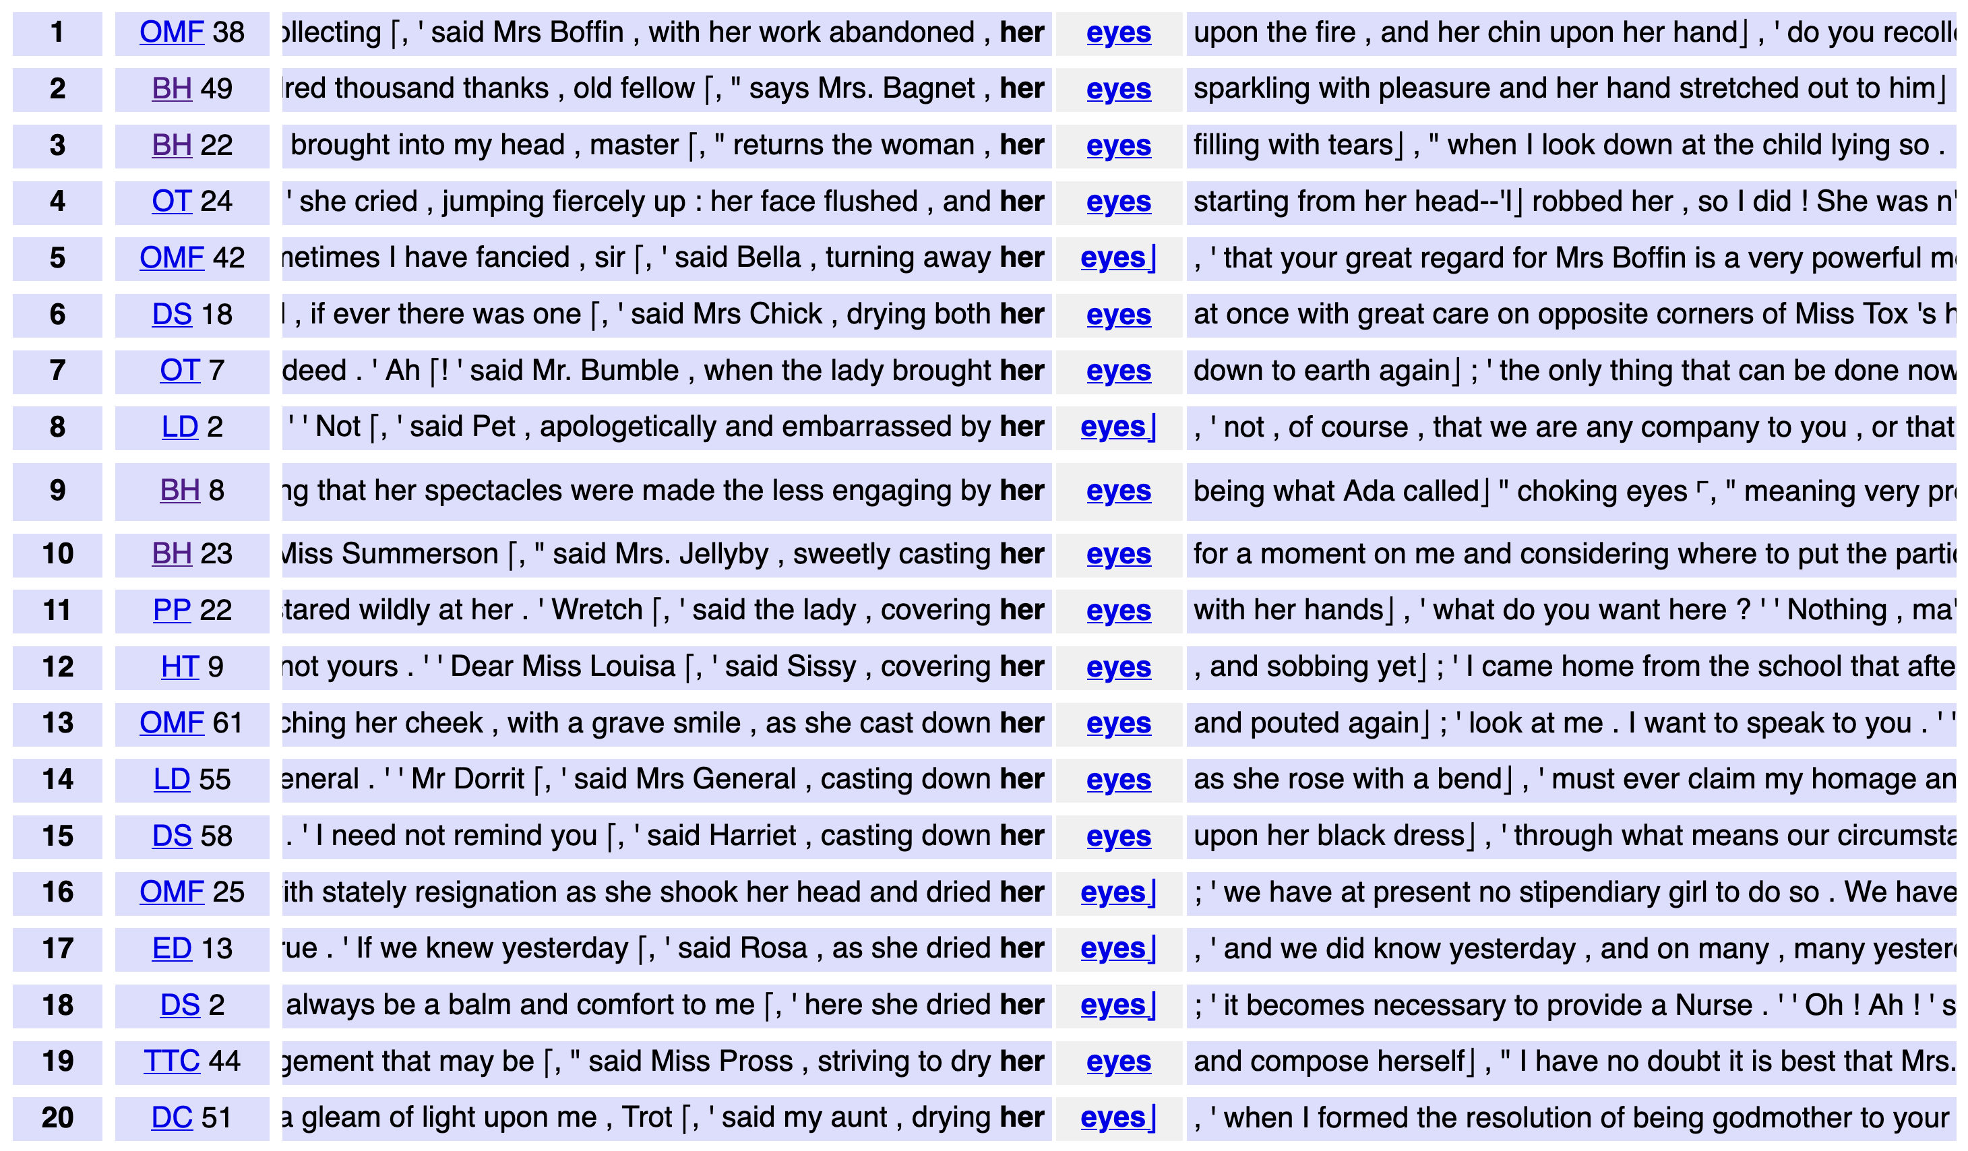
DNOV-CWB
Corpus
"eyes" %c
Query
root node
Partition / Cluster ▼
Analysis Tree
by left context ❎
⨁
arrangement node
Sort
Query result (4031)
▸ sort: random
▸ select: within suspension (276)
• sort: right context
• sort: left context
• partition: by POS tag @ L1, sort: left context
▸ select: set [PRP$] (211)
Make selection ▼
🎔 Bookmark
siblings
subset node
subset
images do not represent actual gameplay

Slide 70
DNOV-CWB
Corpus
"eyes" %c
Query
root node
Partition / Cluster ▼
Analysis Tree
by L1 ❎
⨁
arrangement node
Sort
Query result (4031)
▸ sort: random
▸ select: within suspension (276)
• sort: right context
• sort: left context
• partition: by POS tag @ L1, sort: left context
▸ select: set [PRP$] (211)
• sort: by L1
Make selection ▼
🎔 Bookmark
siblings
subset node
subset
images do not represent actual gameplay

Slide 71
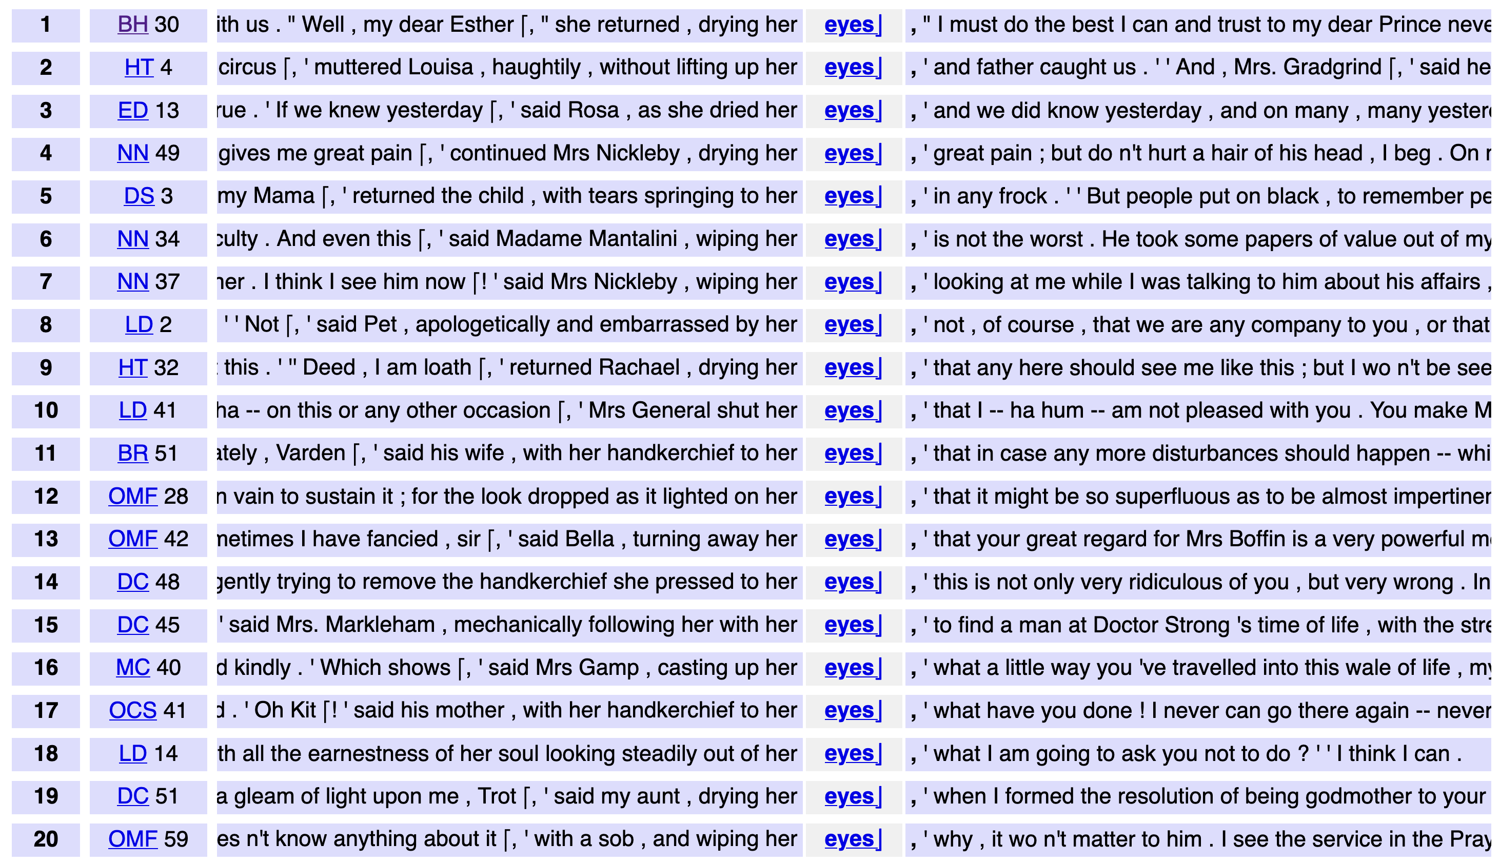
DNOV-CWB
Corpus
"eyes" %c
Query
root node
Partition / Cluster ▼
Analysis Tree
by L1 ❎
⨁
Sort
by right context ❎
arrangement node
Sort
Query result (4031)
▸ sort: random
▸ select: within suspension (276)
• sort: right context
• sort: left context
• partition: by POS tag @ L1, sort: left context
▸ select: set [PRP$] (211)
• sort: by L1
• sort: by L1, sort: right context
Make selection ▼
🎔 Bookmark
siblings
subset node
subset
images do not represent actual gameplay

Slide 72
DNOV-CWB
Corpus
"eyes" %c
Query
root node
Partition / Cluster ▼
Analysis Tree
by L1 ❎
⨁
Sort
by right context ❎
arrangement node
Sort
Query result (4031)
▸ sort: random
▸ select: within suspension (276)
• sort: right context
• sort: left context
• partition: by POS tag @ L1, sort: left context
▸ select: set [PRP$] (211)
• sort: by L1
• sort: by L1, sort: right context 🎔
Make selection ▼
🎔 Bookmark
siblings
subset node
subset
path from root node
bookmark
images do not represent actual gameplay

Slide 73
A mathematical model of organising conc.
Concordance reading = analysis tree consisting of subset nodes and arrangement nodes
subset nodes form the structure of the tree ➞ focus on part of conc.
arrangement nodes = alternative views of the same subset (➞ parent)
arrangement nodes are siblings, subset nodes can be children of either kind
root node = subset node corresponding to full concordance
Subset node = Selecting algorithm with parameters
Arrangement node = ≤ 1 Grouping algorithm with parameters + sequence of Ordering algorithms with parameters
each arrangement node completely overwrites any prior arrangement

Slide 74
Concordance view
Each node in the analysis tree represents a concordance view, i.e. an arrangement of a subset of the concordance
Identifies subset + ordering of conc. lines via line № as unique ID
With Grouping algorithm: list of sets of conc lines specified by line №
Partitioning: ordering of the sets (≠ ordering of lines)
Grouping: ordered tree of the sets + prototypical examples for each set
Optional: supplementary information on concordance lines, sets, and relevant token spans returned by algorithms

Slide 75
Formalising algorithms
Application of an algorithm is conceptualised mathematically as annotation of concordance lines:
Selecting = annotation of a Boolean variable
Sorting = annotation of an integer variable (surrogate keys)
Ordering = annotation of a floating-point variable (preference scores)
Partitioning = annotation of a categorical variable (set membership)
Clustering = annotation of ordered tree of subsets
➞ concordance view derived from annotations

Slide 76
Strategy 1: Selecting
Selecting = add Boolean variable to lines
keep concordance line if value is True
exclude selected lines by logical negation of variable (all algorithms)
Examples
selection based on metadata categories or numerical ranges
select random subset (reproducible, stratified, …)
KWIC filter (lines containing certain words, lemmas, POS tags, …)
manual selection of individual concordance lines (will get back to this)

Slide 77
Strategy 2: Sorting [Ordering]
Sorting = add integer variable with sort keys
pairwise comparison of lines (A < B, A = B, A > B)
resulting sort order ➞ integers as surrogate keys (A < B, A = B, A > B)
ties (A = B) can be broken by additional Sorting or Ranking algorithms
Examples
sort alphabetically by left or right context
sort by POS tag of first (L1) or second (L2) token before node
sort by numerical (e.g. year) or categorical (e.g. author) metadata
random shuffling (reproducible)

Slide 78
Aside: Context trees & KWIC patterns
(Evert, ICAME 2007)
➞ sorting algorithm for concordance reading (Anthony 2022)
… but 3 different versions
The Word Tree (Wattenberg & Viégas, 2008)

Slide 79
Strategy 3: Ranking [Ordering]
Ranking = add floating-point variable to lines
values = preference score assigned to each line
decreasing order: lines with highest scores shown at top
ties can occur e.g. if scores happen to be integer values
Examples
rank by readability, GDEX algorithm, or fit to selected CEFR level
rank by frequency of the node string
rank by similarity to query (for fuzzy search)
rank by number of significant collocates of the node in context, or by number of user-specified keywords (KWIC grouper)

Slide 80
Strategy 4: Partitioning [Grouping]
Partitioning = add partition № to each line
each line assigned to exactly one partition, based on a property of the concordance line (not on comparisons)
also provide ordered list of partitions with display labels, etc.
Examples
frequency breakdown of node strings
partition by POS tag of first (L1) or second (L2) token before node
partition by categorical metadata (variety, genre, speaker info, …)
partition by lemma trigram R1+R2+R3 (similar to KWIC patterns)

Slide 81
Strategy 5: Clustering [Grouping]
Clustering = add ordered tree over lines
based on pairwise similarities of concordance lines
hierarchical clustering ➞ deep tree, flat clustering ➞ single-level tree
tree describes both nesting and preference order of clusters
Examples
clustering based on lexical similarity (shared words), semantic similarity (sentence/word embeddings), or syntactic similarity
clustering based on multiple metadata features ➞ similarity score
all clusterings: either flat or hierarchical, with different algorithms
context tree (on POS tags, lemmas, semantic tags, …)

Slide 82
Strategy 1': Manual Selecting
Selecting based on manual choice made by user
also adds Boolean variable & can be inverted
direct selection of lines vs. indirect (via set ID or supplementary information)
Examples
manual validation of concordance lines (e.g. false positives)
select sets by ID (after Grouping) or range of lines (after Ordering)
threshold based on ranking scores (returned as supplementary info)
“interactive” algorithms (e.g. click individual lines or sets) vs. “non-interactive” algorithms (e.g. top-n lines in ranking)

Slide 83
Research documentation
Analysis tree as research documentation
concordance view uniquely determined by path from root node
bookmarked nodes = basis for interpretation & discussion
Exact reproduction with identical concordance data
readers can reproduce published results completely
but also explore further concordance views
Save / load analysis tree ➞ continue concordance reading later
Analysis tree as template for concordance organisation
“replay” tree on a new concordance (possibly from different corpus)
interactive manual selection has to be omitted (➞ not meaningful)

Slide 84
Time for a break …
Coffee

Slide 85
References
Anthony, L. (2022). What can corpus software do? In O’Keeffe, A. and McCarthy, M. J., editors, The Routledge Handbook of Corpus Linguistics, chapter 9. Routledge, London, 2nd edition
Evert, S. (2007). Context graphs. Presentation at the ICAME 2007 Conference, Stratford upon Avon, UK.
Hunston, S. & Francis, G. (2000). A corpus-driven approach to the lexical grammar of English. Number 4 in Studies in Corpus Linguistics. John Benjamins, Amsterdam.
Luhn, H. P. (1960). Keyword-in-context index for technical literature (kwic index). American Documentation, 11(4):288–295.
Mahlberg, M. & O’Donnell, M. B. (2008). A fresh view of the structure of hard news stories. In Proceedings of the 19th European Systemic Functional Linguistics Conference and Workshop, Saarbrücken, Germany.
Sinclair, J. M. (1966). Beginning the study of lexis. In Bazell, C. E., Catford, J. C., Halliday, M. A. K., and Robins, R. H., editors, In Memory of J. R. Firth, pages 410–430. Longmans, London.
Sinclair, J. M. (1998). The lexical item. In Weigand, E., editor, Contrastive Lexical Semantics, volume 171 of Current Issues in Linguistic Theory. John Benjamins.
Sinclair, J. (2003). Reading Concordances. Pearson Education, Harlow.
Wattenberg, M. & Viégas, F. B. (2008). The word tree, an interactive visual concordance. IEEE Transactions on Visualization and Computer Graphics, 14(6):1221–1228.

